Slide 1
Equity Commission Public Meeting #4
January 31, 2023

Slide 2
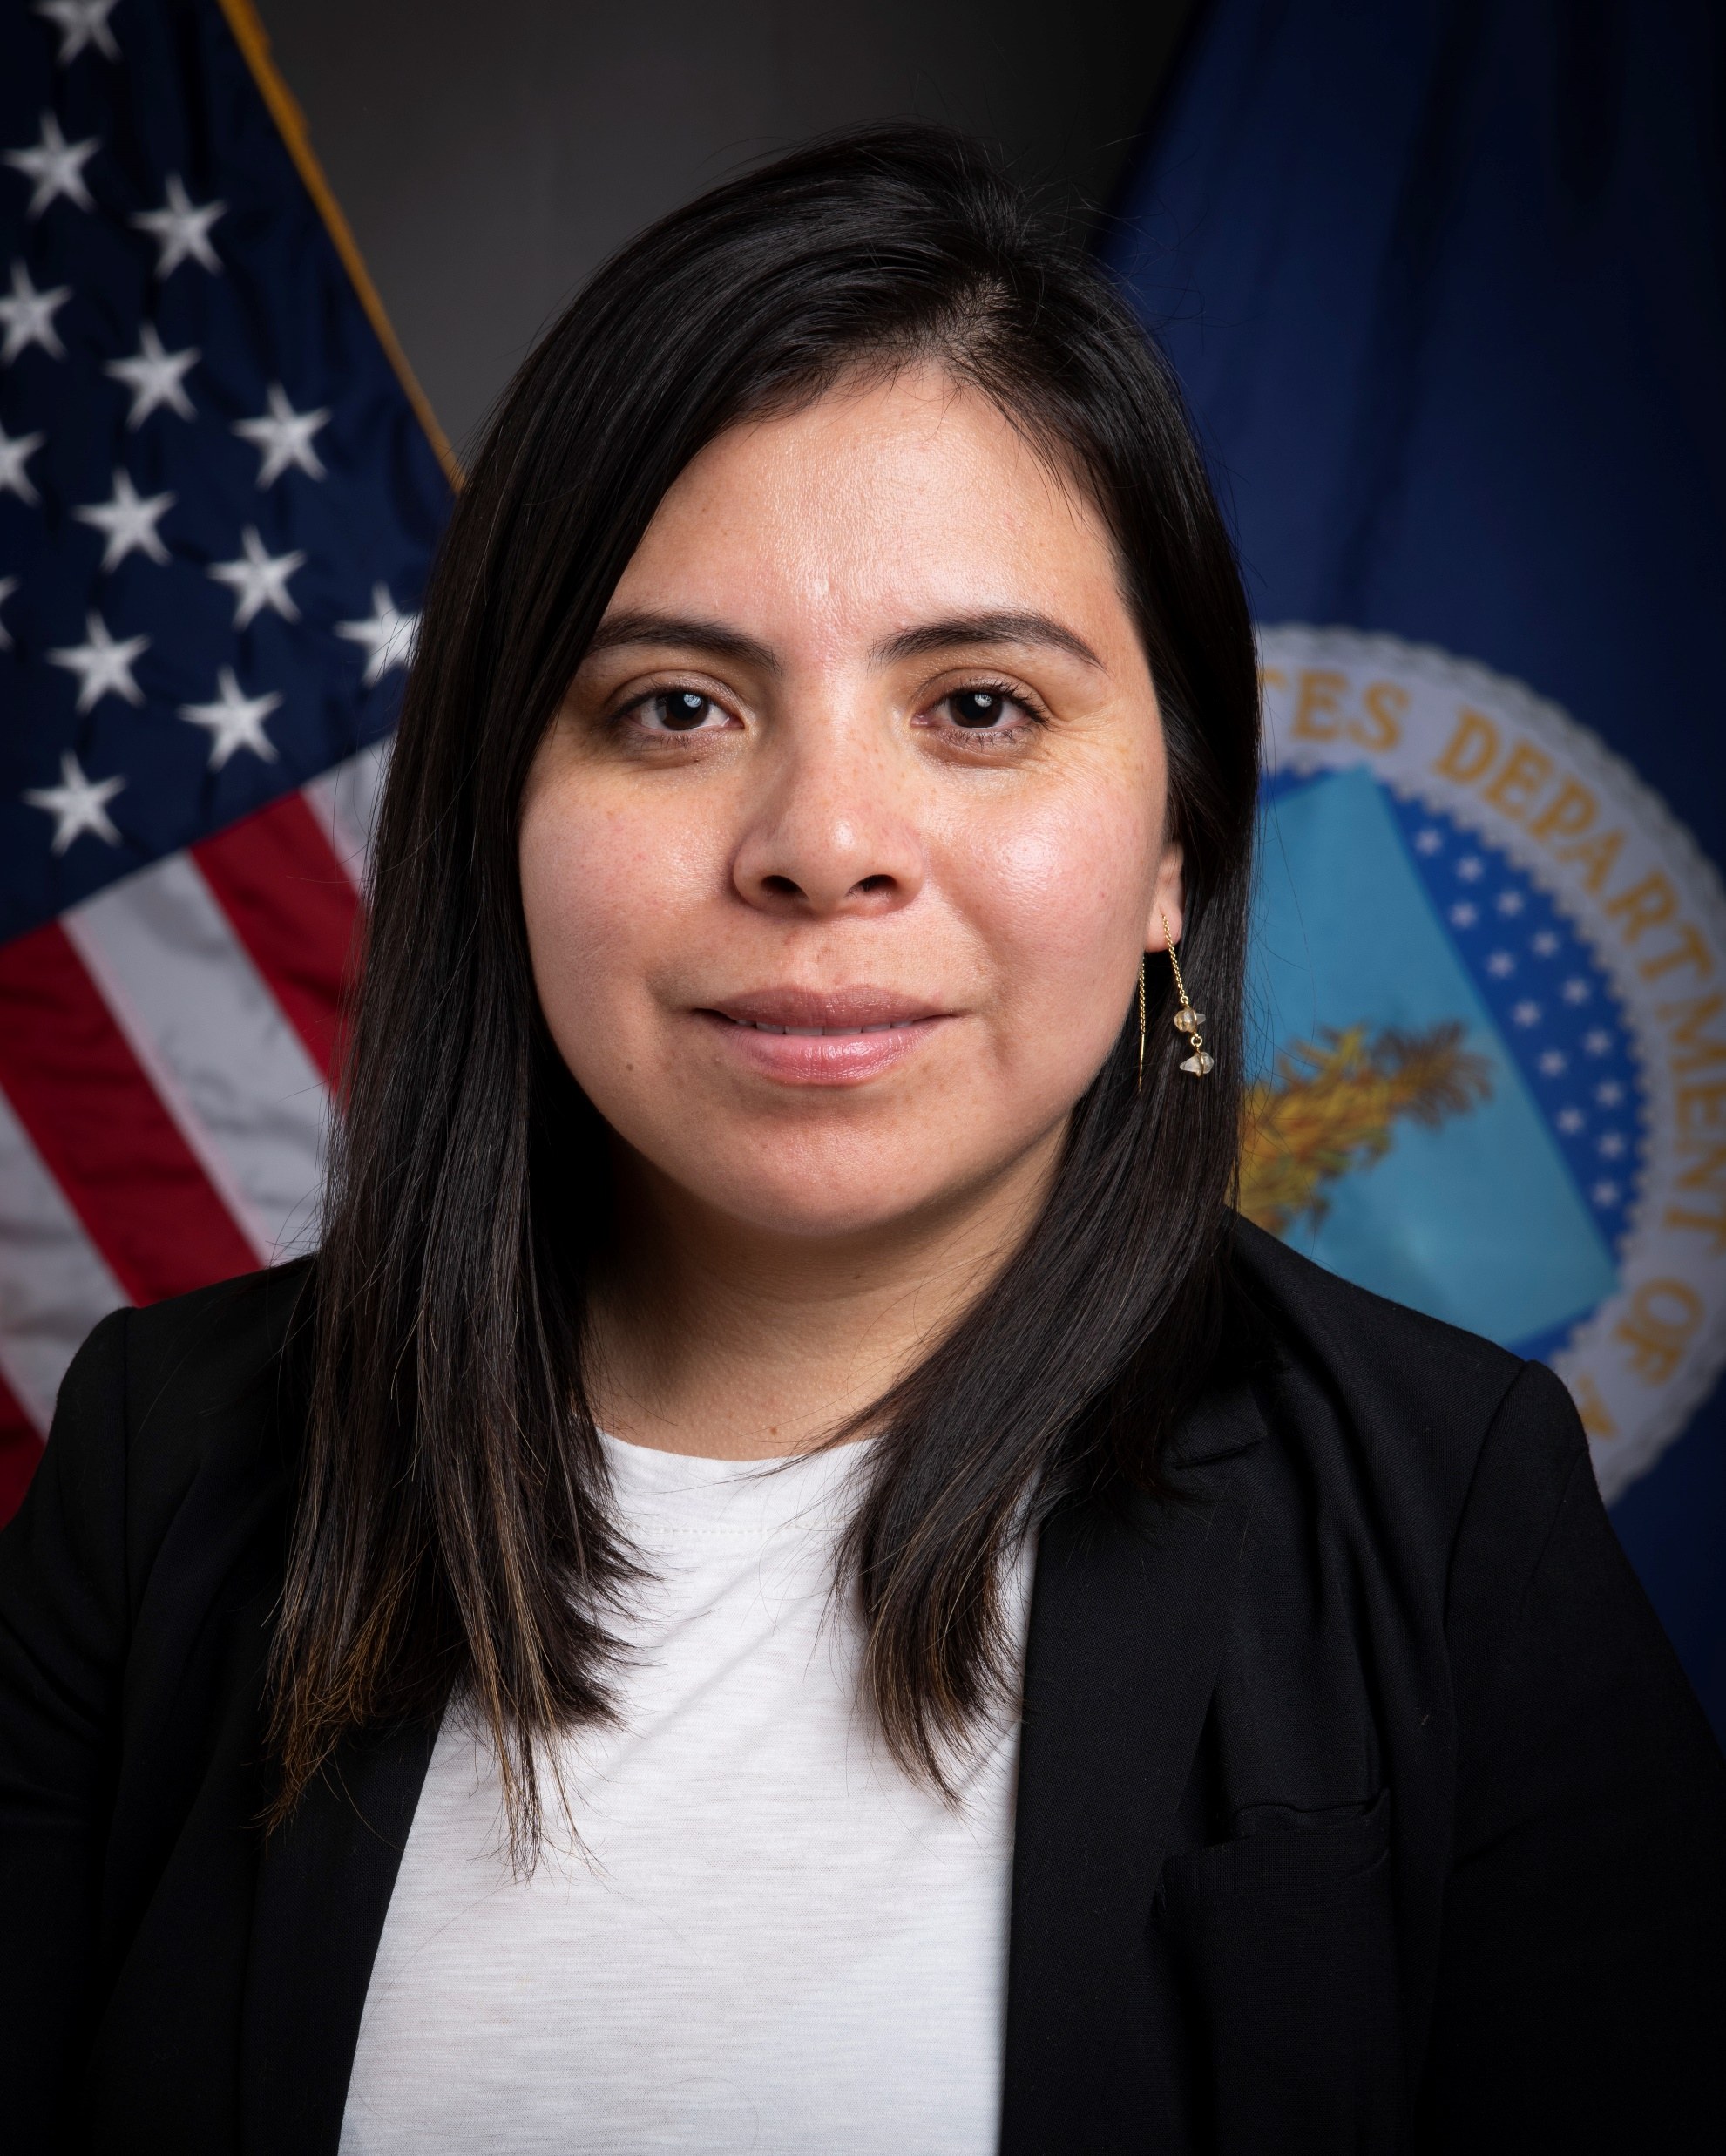
Call to Order
Cecilia Hernandez
Designated Federal Officer

Slide 3
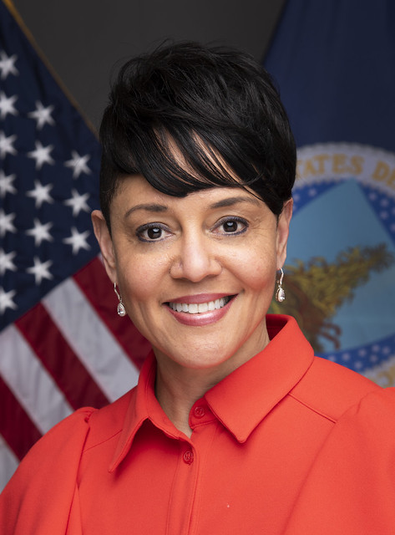
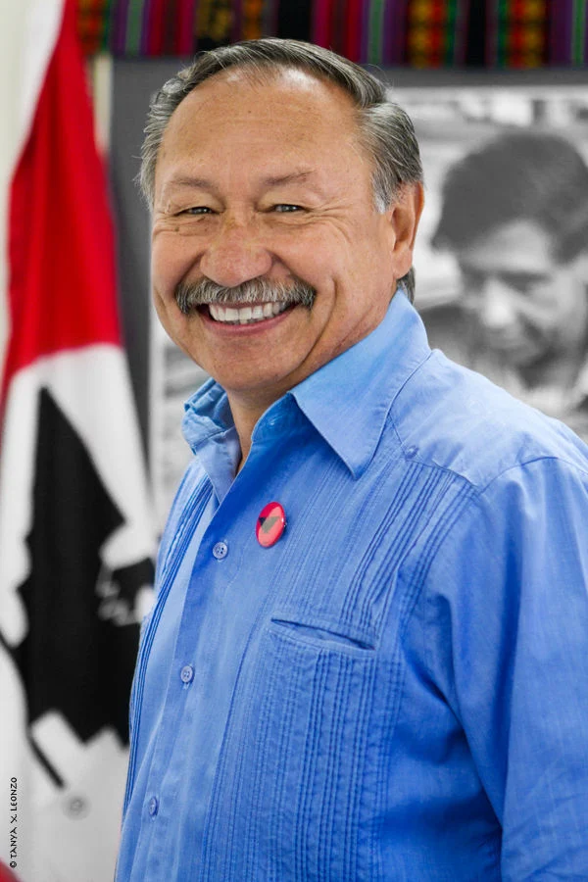
Welcome from the Equity Commission
Co-Chairs
Dr. Jewel Bronaugh
Co-Chair and Deputy Secretary of Agriculture
Arturo S. Rodriguez
Co-Chair and President of the United Farm Workers of America

Slide 4
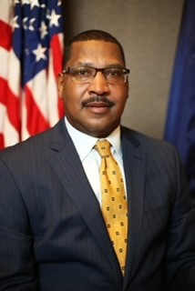
Welcome from USDA Rural Development Leadership
Homer Wilkes
Undersecretary for Natural Resources and Environment

Slide 5
Agenda
Rural Development Modernization Efforts
Rural Development Place-Based Initiatives
Lunch
Public Comment Period
RCED Focus Area Progress Presentations
Discussion on Potential Recommendations
Adjourn

Slide 6


Modernization of Rural Development
Equity Commission | January 31, 2023

Slide 7

Rural Development Modernization Efforts
Farah Ahmad
Deputy Undersecretary for Rural Development

Slide 8
What does #ModernizingRD mean?
Messaging
IT Investments
Staff and Capacity

Slide 9
Messaging: Then and Now
Research and focus groups inform new approach and new messages.
Then
Now
Example
Programs
Banks
Housing
Rural People
Community Trust Neighbor
A Place to Call Home
When rural people thrive,
America thrives
USDA/RD acts as a neighbor, and often is, living next door, building partnerships and offering opportunities for rural people to prosper.
Grants, loans, and loan guarantees from USDA/RD and its partners help make rural America a place everyone can call home.

Slide 10
IT Infrastructure
Systems to Be Updated or Replaced
PLAS
Hyperion
UNIFI

Slide 11

Rural Development’s Strength

Slide 12
Trends
85%
Portfolio
30%
Staff Level

Slide 13
The Balance
Continue to strengthen our workforce
Upgrade our information technology infrastructure
How do we balance this tradeoff given new context?

Slide 14
Break
BREAK

Slide 15
Place-Based Initiatives

Slide 16
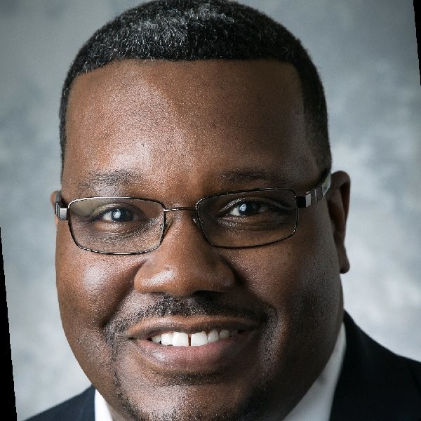
Lee Jones,
Executive Director of Rural Partners Network

Slide 17


Rural Partners Network
Advancing equitable rural prosperity through local job creation, infrastructure development, and community improvement.

Slide 18
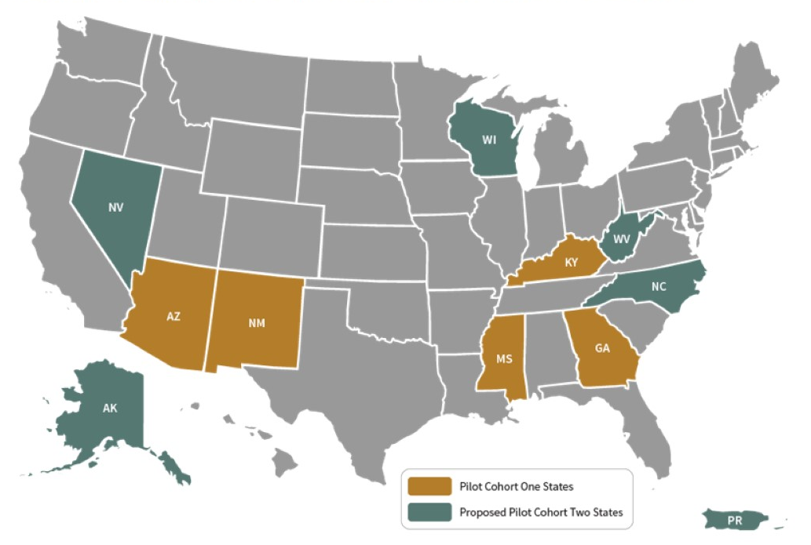
Rural Partners Network Pilot States
Cohort One States: Georgia, Kentucky New Mexico, Mississippi and Three Tribes in Arizona
Cohort Two States and Territory: Alaska, Nevada, North Carolina, Puerto Rico, Wisconsin, and West Virginia

Slide 19
Community Liaisons and national Community Liaisons and national and regional TA providers and regional TA providers
Advocate for rural community needs; addressing barriers and equitable access
Matchmake between community needs and agency resources and staff
Convene Partners:
Federal, Tribal, state, and local governments, non-profits, and other private stakeholders
Provide technical assistance and capacity building support
18

Slide 20
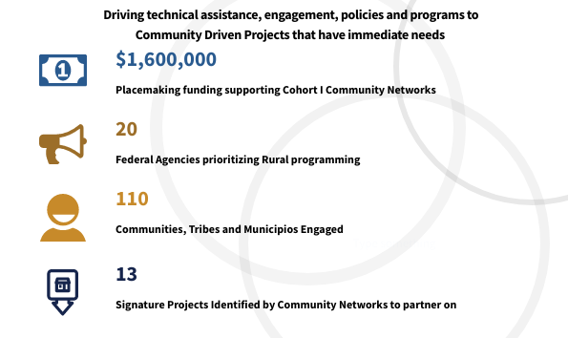
Delivering Improved Outcomes for Rural America
19

Slide 21
Resources: Click and Connect
Questions? Email: RuralPartnersNetwork@USDA.gov
Website: Rural.gov
  Opportunity to subscribe to receive the latest RPN Updates on the website.
Twitter: @ruralgov
Newsletter: Rural Connections-click to subscribe

Slide 22


Closing America’s Wastewater Access Gap Community Initiative
Closing America’s Wastewater Access Gap Community Initiative

Slide 23
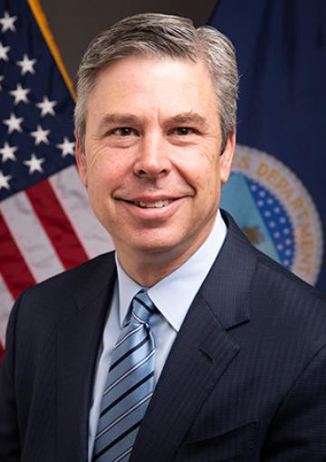
Andrew Berke,
Rural Utilities Service Administrator
22

Slide 24
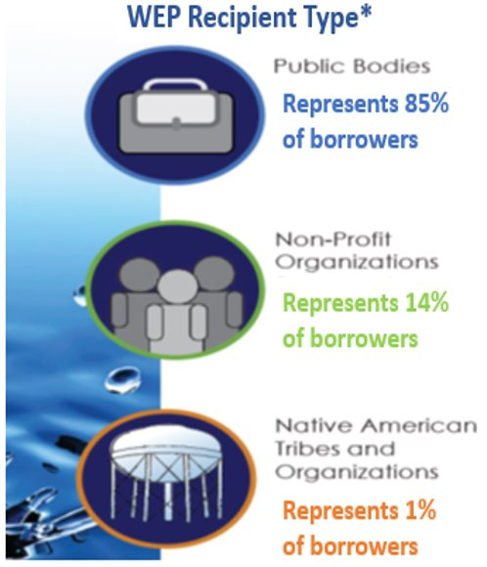
General Overview- Water Programs
  Mission: “Provide loan and grant funds for water and waste projects serving the most financially needy communities...[at] reasonable user costs…”
  Water and Environmental Programs (WEP) finances water and waste systems to provide affordable services to rural areas with populations of 10,000 or less. The Guaranteed Loan Program now serves communities of up to 50,000.
  WEP can finance the acquisition, construction or improvement of:
      Drinking water: sourcing, treatment, storage and distribution
      Wastewater: collection, transmission, treatment, and disposal
      Solid waste: collection, disposal and closure
      Storm water: collection, conveyance and disposal
  WEP’s programs are administered through 47 USDA Rural Development (RD) State Offices and hundreds of field offices throughout rural America.

Slide 25
The Challenge
Too many communities in the United States are still living without the basics—including safe and reliable drinking water and wastewater systems.
An estimated 2.2 million people in the U.S. lack basic running water and indoor plumbing in their homes.
The story of Lowndes County, Alabama was featured in a 60 Minutes story in 2021.
Inadequate and failing wastewater infrastructure poses direct health risks to families and stymies economic growth and community vitality.

Slide 26
Closing the Wastewater Access Gap Community Initiative
The Bipartisan Infrastructure Law (BIL) presented a historic opportunity to invest in communities. EPA and USDA-RD are jointly leveraging technical assistance resources to help historically underserved communities identify and pursue federal funding opportunities to address their wastewater needs.
This initiative is being piloted in 11 communities in the following states: Alabama, Kentucky, Mississippi, New Mexico, North Carolina, West Virginia. Also included are the tribal nations of Santo Domingo Pueblo and San Carlos Apache
Some of these places are also Rural Partners Network communities.

Slide 27
Key Activities in the Closing the Wastewater Access Gap Community Initiative
Conduct a Community Wastewater Assessment
Develop a Wastewater Community Solution Plan
Help Underserved Communities Identify and Pursue Funding Opportunities
Build Long-Term Capacity
The Closing America’s Wastewater Access Gap Community Initiative will also provide a roadmap that can be scaled to additional communities across the country.

Slide 28
Break
BREAK

Slide 29
Public Comment Period
Oral Comment Process
Commenters signed up prior to meeting during registration
Commenters were offered a pre-meeting to prepare and solve tech issues
Commenters will now have 1:30 minute per oral comment
How to Provide Written Comments
Submit comments to equitycommission@usda.gov
Comment period will close on 2/17
Compilation of written comments will be posted to the website

Slide 30
RCED Subcommittee Goals (1/2)
Improving technical assistance, capacity building, and place-based economic development strategies necessary for navigating and accessing USDA programs and services.
Improving access to capital for business growth and development in rural and tribal communities.
Improving USDA’s program delivery strategy to ensure investments are equitable now and into the future, including data-driven outreach and program design.
Reducing climate pollution, implementation of environmental justice standards, and better management of natural resources.
Minimizing disproportionate effects of climate change by increasing infrastructure resilience and economic support to rural and tribal communities.
Improving access to high-speed internet for all rural and tribal residents.
Ensuring equitable access to safe, affordable housing.

Slide 31
RCED Subcommittee Goals (2/2)
Ensuring equitable access to safe, affordable, and resilient water and wastewater infrastructure.
Improving equitable and sustainable access to natural resources, including recreational facilities.
Enhancing customer service via improved USDA staffing, training, IT modernization, and transformation of the organizational culture within USDA.
Improving use of data and technology both to ensure access to programs and services and to increase accountability.
Improving USDA performance measures and program evaluation so that the implementation of recommendations can be monitored, tracked, and reported with real outcomes.
Making USDA accountable by requesting an implementation strategy and an action plan on recommendations.

Slide 32
RCED Subcommittee Discussions/Process
Overarching Themes:
Programs and Services
Rural Business
Rural Infrastructure
Natural Resources Management
Cross-cutting Themes:
Access
Outreach, Community Engagement, Technical Assistance, and Awareness
Delivery of Programs
Tribal Affairs
Training, Customer Service
Data and Metrics
Accountability
Staffing/Resourcing Structural changes and how they affect delivery of services
Focus Areas:
Transformational Capacity Building and Access
Rural Housing and Infrastructure
Community Facilities
Rural Business
Utilities

Slide 33
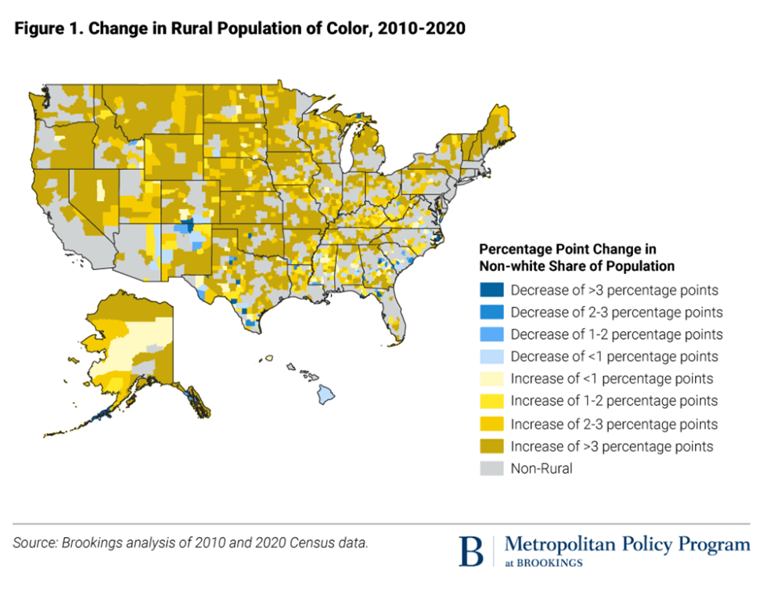
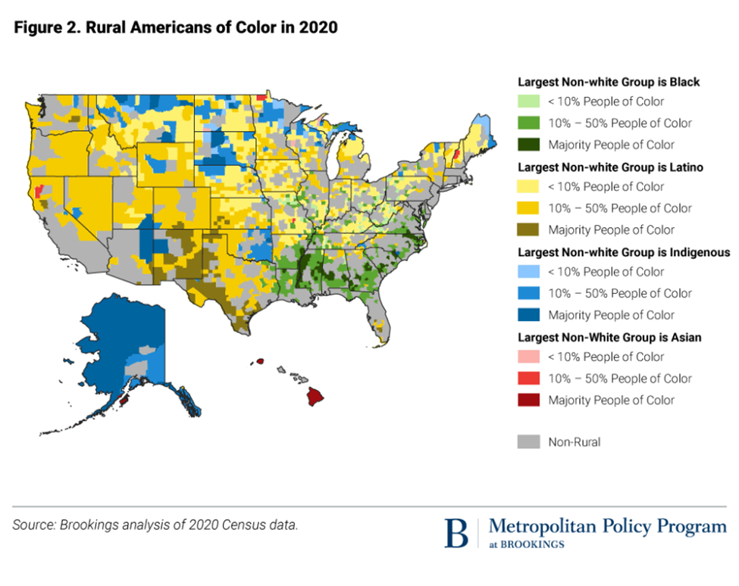
Rural Communities in Context
46.1 million People reside in rural counties
Over 50% of rural Black residents and over 45% of rural Native Americans live in economically distressed counties
Over 85% of persistent poverty counties are rural
11 Million new rural residents (2010 to 2020) identify as a racial/ethnic minority

Slide 34
RCED Focus Area: Transformational Capacity Building and Access
Issues
Staffing
Technology
Access to programs
Program delivery and organizational change
Definition of success and data monitoring
Key Considerations for Recommendation Development
Implementation feasibility
Organizational and systemic change
Ongoing agency responsiveness and relevancy
DRAFT // PRE-DECISIONAL

Slide 35
RCED Focus Area: Transformational Capacity Building and Access (1/3)
Issue: Program Delivery and Staffing
Limited capacity
Compliance driven
Location
Community understanding
Preliminary Recommendation Areas
that are Emerging
Deploy more pilots such as the Rural Partner Network.
Make technology reporting improvements for recipients and staff.
Increase contracted partnerships through larger, multi-year capacity building grants.
In ADDITION to USDA staff, establish a paid Rural State Technical Assistance Committees to assist projects/programs who need direction and review of proposals.
Create near term field staff or partnership contracting targets and ensure additional federal investments are dedicated to stated targets (salaries and benefits).
Allow more field staff to work remotely as appropriate to increase applicant candidate labor pool.
DRAFT // PRE-DECISIONAL

Slide 36
RCED Focus Area: Transformational Capacity Building and Access (2/3)
Issue: Defining Success and Data Monitoring
Definition of success
Quantitative vs. qualitative measures
Data collection
Data transparency
Data analysis on WHO is being served
Measurement of LOCAL ownership and livelihoods
Preliminary Recommendation Areas
that are Emerging
Collect baseline data now, with expressed targets to dashboard.
Third party measurement, using qualitative & quantitative
Leverage the Evidence Act as a way to drive better data and more transparent data.
Leverage the FAS internal evaluation and overseas process of measuring impactful outcomes/outputs
Leverage the Office of Policy and Development & Research to collect, analyze and report ANNUAL data.
Train staff about effective measurement as part of the onboarding process – and USDA train practitioners.
DRAFT // PRE-DECISIONAL
Notes:
.

Slide 37
RCED Focus Area: Transformational Capacity Building and Access (3/3)
Issue: Funding Loans and Grants
Matching requirements
Micro-lending programs
Farm Credit System Role
Preliminary Recommendation Areas
that are Emerging
Consistent development and communication of eligibility requirements
Loan forgiveness/scaled forgiveness/ safety net
Template library for applications
GIS Persistent Poverty overlayed with where money is going
Look at existing authorities that could be re-framed to better serve rural families
DRAFT // PRE-DECISIONAL

Slide 38
RCED Focus Area: Rural Housing and Infrastructure
Issues
Funding sources for private-public partnerships
Affordable housing and community development
Housing conditions
Displacement prevention
Preliminary Recommendation Areas
that are Emerging
Address disparities in the quality of infrastructure, community facilities, and housing.
Finance construction and ensure governance questions speak to equity.
Re-focus incentives to buy multi-family units.
Fund resident-led community initiatives.
Institutionalize decision-making to ensure projects do not displace communities.
DRAFT // PRE-DECISIONAL

Slide 39
RCED Focus Area: Community Facilities
Issues
Funding mechanisms
Multi-use community facilities
Preliminary Recommendation Areas
that are Emerging
Enhance funding for public/ private sources that provide essential services (education, childcare, fire and healthcare).
Ensure multi-use community facilities are permitted to apply for and receive grants for government agencies.
DRAFT // PRE-DECISIONAL

Slide 40
RCED Focus Area: Rural Business
Issues
Cooperatives and Small Businesses
Preliminary Recommendation Areas
that are Emerging
Broaden the idea of funding infrastructure to include all aspects of life to support rural communities.
Consider not-for-profit organizations for housing.
Remove barriers for minority groups to access programs.
Consider how to support co-ops in understanding and implementing co-op governance.
DRAFT // PRE-DECISIONAL

Slide 41
RCED Focus Area: Utilities (Pt. 1)
Issues
Broadband
Oversight of USDA grants and loans for utility companies
Edge of Grid Lending and Investments such as EECLP
Rural Energy for America Program (REAP)
Rural Water
Preliminary Recommendation Areas
that are Emerging
Examine or support others who are examining the broadband census track methodology and rules that determine where broadband currently exists.
Eliminate the current ‘one-and-done’ funding stipulation.
Recognize and further support the need for ‘operational technology’ investments that require broadband.
DRAFT // PRE-DECISIONAL

Slide 42
RCED Focus Area: Utilities (Pt. 2)
Issues
Broadband
Oversight of USDA grants and loans for utility companies
Edge of Grid Lending and Investments such as EECLP
Rural Energy for America Program (REAP)
Rural Water
Preliminary Recommendation Areas
that are Emerging
Incorporate Justice 40 initiative implementation guidelines.
Ensure utilities and other eligible entities applying for funds demonstrate a commitment to supporting underserved communities; ensure accountability and transparency.
Continue Edge of Grid lending and investment.
DRAFT // PRE-DECISIONAL

Slide 43
RCED Focus Area: Utilities (Pt. 3)
Issues
Broadband
Oversight of USDA grants and loans for utility companies
Edge of Grid Lending and Investments such as EECLP
Rural Energy for America Program (REAP)
Rural Water
Preliminary Recommendation Areas
that are Emerging
Eliminate the requirement for a SAM and UEI number for REAP program applications.
Continue education for tribal entities, rural electric cooperatives and other stakeholders.
Provide grant assistance at the USDA State or National offices to bolster areas where this type of help is expensive or not readily available.
DRAFT // PRE-DECISIONAL

Slide 44
RCED Focus Area: Utilities (Pt. 4)
Issues
Broadband
Oversight of USDA grants and loans for utility companies
Edge of Grid Lending and Investments such as EECLP
Rural Energy for America Program (REAP)
Rural Water
Preliminary Recommendation Areas
that are Emerging
Hold Rural Water Associations accountable for equitably distributing the funds to socially disadvantaged groups.
DRAFT // PRE-DECISIONAL

Slide 45
Break
BREAK

Slide 46
Dialogue on Potential Recommendations

Slide 47
Thank you for Joining!
Please join us tomorrow using the same link.
To provide public written comments, please email the Equity Commission inbox at equitycommission@usda.gov. Comment Period closes 2/17.
To learn more about equity initiatives at USDA, visit www.usda.gov/equity.

Slide 48
Equity Commission Public Meeting #4
February 1, 2023

Slide 49
Call to Order
Cecilia Hernandez
Designated Federal Officer

Slide 50
Agenda
History of U.S. Farm Policy and its Implications to Achieving Equity
Lunch
Equity In Procurement
USDA Budget Overview
Discussion on Interim Recommendations
Adjourn

Slide 51

History of U.S. Farm Policy
Jonathan Coppess
Associate Professor at University of Illinois Urbana-Champaign
College of Agricultural, Consumer & Environmental Sciences

Slide 52
History of U.S. Farm Policy
Notes:
Switch decks

Slide 53
Break
LUNCH BREAK

Slide 54
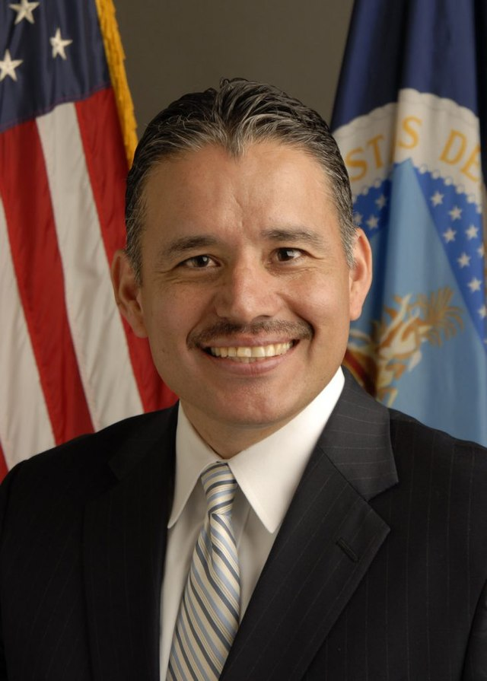
Equity in Procurement
Oscar Gonzales
Assistant Secretary for Administration

Slide 55
What is the OSDBU?
An office established to maximize prime and subcontracting opportunities for U.S. Small Businesses. The efforts of the OSDBU assist with equity in procurement, maintain a viable and innovative industrial base, and support various USDA missions.
Federal Acquisition Regulation (FAR) 19.201 and the Small Business Act (15 U.S.C 644) requires that every federal agency with contracting authority establish an OSDBU.
Small business inclusion in federal contracting is a longstanding government-wide policy objective.

Slide 56





OSDBU Duties and Purpose
Develops and promotes strategies for small business participation in USDA contracting programs.
Manages the USDA-wide small business program.
Works with industry, USDA acquisition professionals, the USDA Office of Contracting and Procurement Officer, the Heads of USDA Buying Agencies, and small business specialists and program offices to maximize prime and subcontracting opportunities.
Performs outreach to small businesses
Must adhere to the requirements in the Small Business Act.

Slide 57




OSDBU Duties and Purpose
Conducts internal training on federal small business contracting programs.
Is separate and distinct from contracting.
Supports the longstanding government-wide policy objective to maximize opportunities for small businesses in federal contracting.
Makes sense! Small businesses create jobs, support the economy, and provide innovative solutions. The Federal Government is the largest buyer of goods and services in the world. Federal Small Business Contracting Programs were created to “level the playing field.”

Slide 58
Executive Order 13985
President Biden, on his first day in office, issued Executive Order 13985, Advancing Racial Equity and Support for Underserved Communities through the Federal Government, Executive Order on Diversity, Equity, Inclusion, and Accessibility in the Federal Workforce | The White House
Directs agencies to make Federal contracting and procurement opportunities more readily available to all eligible vendors and to remove barriers faced by underserved individuals and communities
The term “equity” means the consistent and systematic fair, just, and impartial treatment of all individuals, including individuals who belong to underserved communities that have been denied such treatment, such as Black, Latino, and Indigenous and Native American persons, Asian Americans and Pacific Islanders and other persons of color; members of religious minorities; lesbian, gay, bisexual, transgender, and queer (LGBTQ+) persons; persons with disabilities; persons who live in rural areas; and persons otherwise adversely affected by persistent poverty or inequality.
The term “underserved communities” refers to populations sharing a particular characteristic, as well as geographic communities, that have been systematically denied a full opportunity to participate in aspects of economic, social, and civic life, as exemplified by the list in the preceding definition of “equity.”

Slide 59
Executive Order 13985
Increase in share of small disadvantaged business (SDB) contracts to 15% by 2025.
OSDBU implements policies, procedures, and outreach programs to emphasize the Department’s commitment to contracting with SDBs, including businesses with characteristics that align with the definition of underserved communities.
Although several of OSDBU’s programs have distinct purposes, missions, and legal frameworks, opportunities exist to improve and promote engagement with underserved communities, particularly through outreach and stakeholder support.

Slide 60
OMB Memorandum 22-03
OMB Memorandum 22-03, Advancing Equity in Federal Procurement
  Issued December 2, 2021
  Memoranda | The White House
  Five areas of focus:
    Agency specific small disadvantaged business (SDB) goal for FY 2022 that will allow the Federal Government to award at least 11% of Federal contact spending to SDBs. USDA goal is 21.5%.
    Increase the number of new entrants to the Federal marketplace.
    Include the achievement of small business contracting goals as a part of the performance plans for key Senior Executive officials.
    Ensure agency small business contracting offices (OSDBUs) have access to senior leadership.
    Change in category management practices to boost contracting opportunities for SDB’s and other socioeconomic small businesses
      Biggest takeaway for acquisition community: Category Management Plans shall not prioritize spending on “Best in Class” (BIC) solutions at the expense of meeting socioeconomic small business goals and providing maximum practicable opportunity to small businesses

Slide 61
OSDBU Small Business Outreach
In Fiscal Year (FY) 2021, the USDA’s Office of the Assistant Secretary for Administration (OASA) established a training series entitled “USDA Small Business Workshops” to support and assist small, rural, women, veteran, and other disadvantaged businesses access procurement opportunities in 11 targeted States and territories with limited procurement awards. – (Arizona, Georgia, Mississippi, Montana, New Mexico, North Carolina, North Dakota, Oklahoma, Vermont, Puerto Rico, and the Virgin Island)
Additionally, USDA partners with the FDIC and SBA to provide individuals, small businesses, and communities, useful information, tools, resources, and an opportunity to engage in discussions to create economic progress. The Regional business development series, entitled “Path to Prosperity”, features experts in the lending industry, Federal Government, community partners and stakeholders. Other partners and stakeholders include, but not limited to, the Internal Revenue Service, Chambers, SCORE, Small Business Development Centers, and Procurement Technical Assistance Centers.

Slide 62
Fiscal Year 2023 Outreach Activities
FY 2023 Outreach Activities Conducted and Planned include:
  October 2022 – AUSA Conference and Matchmaking Event at Washington DC Convention Center
  November 2022 – Native American Heritage Month – Tribal Nations Forum at Bacone University, Muskogee, Oklahoma
  December 2022 – USDA/Prairie View University Forum with Minority Suppliers and Farmers
  January 2023 – Delaware Procurement Technical Assistance Center Road Show
  February 2023 – USDA/GSA HBCU Initiative @ Jackson State University
  March 2023 – Puerto Rico and Virgin Islands Path to Prosperity Regional Series
  March 2023 – Kentucky Chamber, USDA/SBA Procurement Workshop
  April 2023 – Mississippi Path to Prosperity Regional Series that will encompass Louisiana, Alabama, Arkansas, and Oklahoma
  May 2023 – National Small Business Week - Georgia Path to Prosperity Regional Series that encompass Florida, South Carolina, North Carolina, and Tennessee May 2023 (tentative) – West Virginia Path to Prosperity Series that will encompass Maryland, Ohio, Pennsylvania, Virginia
  May 2023 USDA/SBA/PTAC Outreach Event in Rapid City South Dakota
  June 2023 (tentative) – Montana Path to Prosperity Regional Series that will encompass North Dakota, South Dakota, and Wyoming
  July 2023 (tentative) – Arizona Path to Prosperity Regional Series that will encompass Colorado, New Mexico, Texas, and Utah
  August 2023 (tentative) – Vermont Path to Prosperity Regional Series that will encompass New York, Maine
  September 2023 (tentative) – Hawaii Path to Prosperity Regional Series that will encompass Guam

Slide 63
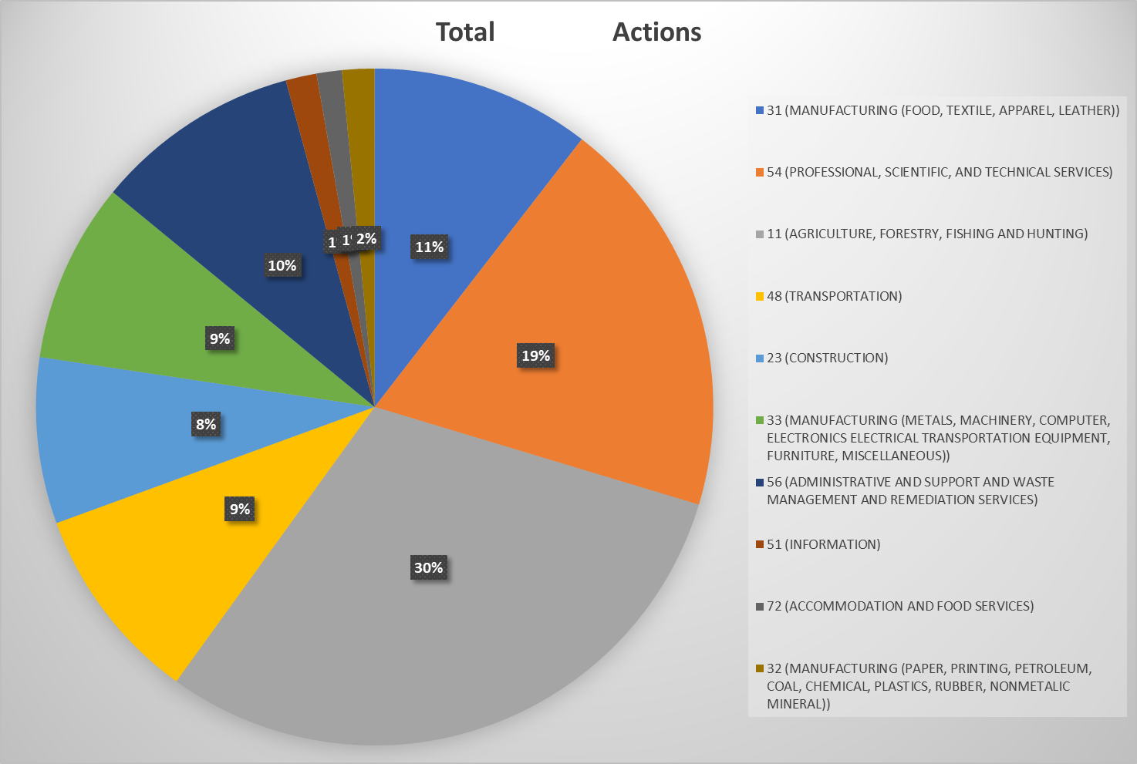
Fiscal Year 2022 USDA Purchasing Environment

Slide 64
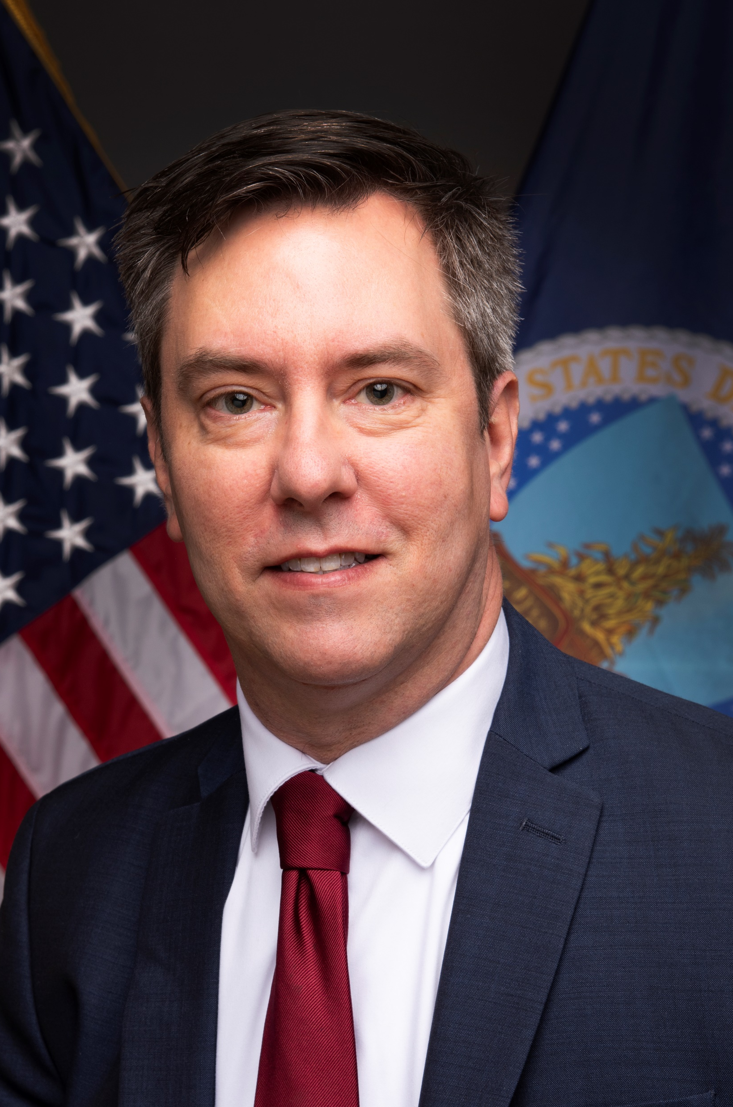
USDA Budget Overview
John Rapp
Director of the Office of Budget and Program Analysis
Notes:
Need photo

Slide 65
Agenda
  USDA’s Budget Authority Overview
  Budget Formulation
  Inflation Reduction Act (IRA) and American Rescue Plan Act (ARPA)

Slide 66
USDA’s Budget Authority
Overview of USDA’s Total Budget Authority
  Discretionary
  Mandatory
  Supplemental

Slide 67
USDA’s Budget Authority

Slide 68
USDA’s Budget Authority

Slide 69
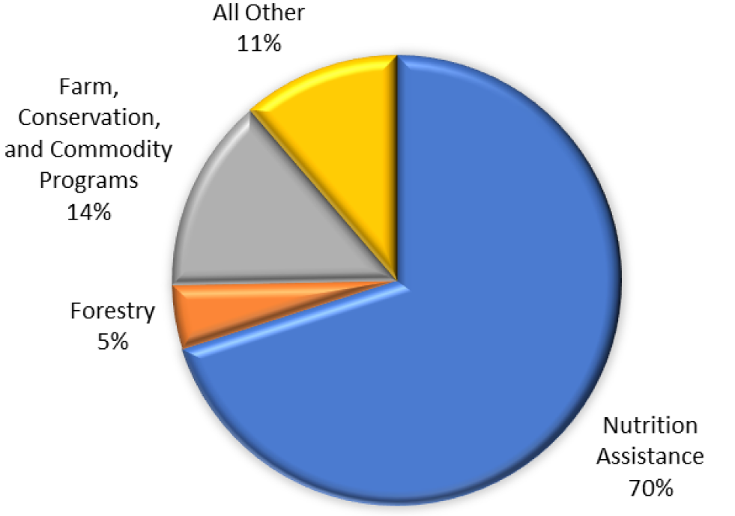
USDA’s Budget Authority
2023 Mandatory and Discretionary Outlays
All Other includes:
Rural Development
Research
Food Safety
Marketing and Regulatory
Departmental Management

Slide 70
Budget Formulation Process
Who is involved in budget formulation?
First, the Players…
Congress
President
Budget Committee
Office of Management and Budget (OMB)
Subcommittee on Agriculture,
Rural Development, FDA,
& Related Agencies
Dept. of Agriculture
Subcommittee on
Interior, Environment
& Related agencies
Agencies and Staff
Offices
Legislative Branch
Executive Branch

Slide 71
Budget Formulation Process
November
September
December
February
October
January
March
August
April
May
June
July
Current Year
Defending the Budget
Planning Year/Out-Year
Planning
Two Years Out

Slide 72
One Time Funding Sources
Supplemental – One time funding sources
  IRA
  Infrastructure
  ARPA
  Covid Related Supplementals

Slide 73
Questions
Questions?

Slide 74
Break
BREAK

Slide 75
Discussion on Interim Recommendations
Discussion Ground Rules
Share the floor, only one speaker at a time- everyone speaks once before someone speaks twice (on a particular line item)​
Stay focused on the issue and recommendation at hand​
Be specific and succinct in request for: ​
Clarification: Ask about the meaning of wording or terminology used​
Use “I” statements when expressing point of view; keep stakeholders in mind​
Acknowledge breadth of pre-work; trust the process and each other

Slide 76
Proposed Interim Recommendation #7
Base Acres Modernization
Modernize base acre policies to address the concern of producers’ inability to receive necessary program payments that help stabilize on-farm revenue during economic downturns with commodity markets.
The base acre modernization would support a combination of one or more of the following:
Review base acre farm program payment calculations and consider redistribution of base acreage to address disparities among farmers. Determine commodity specific base acres on lands historically not included in the initial base acre establishment.
Allow cost-shared improvements to significantly inferior base acres in a prioritized format.
Allow re-establishment of CABs after improvements are completed. As an alternative, allow significantly inferior base acres to qualify for an annual revenue adjustment based on county or regional discrepancies.
DRAFT // PRE-DECISIONAL

Slide 77
Proposed Interim Recommendation #8 (1/4)
County Committees
Address historical and present-day inequitable services by making County Committees more equitable.
Training:
  Require training related to American Indian, Alaska Natives, Native Hawaiian, and Pacific Islander issues where a high number of Tribal producers or Indian and Indigenous communities exist.
  Include the appeals process and role of the minority advisor in training for new committee members.
  Train County Committees to exercise their voting powers and use the tools at their disposal to ensure members can vote without retribution or sense of retribution for voting actions.
Accountability:
  Increase transparency and accountability for County Committee staff by establishing controls and mechanisms to ensure they adhere to equitable standards and have access to USDA resources. County Committee staff should be subject to oversight with civil rights, equity, and demographic indicators of the county.
DRAFT // PRE-DECISIONAL

Slide 78
Proposed Interim Recommendation #8 (2/4)
County Committees
Address historical and present-day inequitable services by making County Committees more equitable.
Accountability:
  Immediately implement a process to ensure that County Committee minority advisors have access to the FSA Administrator to bring in real time issues or concerns within the county and an annual report or accounting to the Administrator on how that committee is operating.
Representation:
  Appoint a minority VOTING member in areas of high proportion of minority farmers without representation.
  Consider a minimum percentage of representation required that is reflective of population for County Committee member vote. For example, if 10 percent of the county population consists of minority farmers and ranchers, approximately at a minimum, 10 percent of the County Committee representation should consist of voting minority farmers and ranchers reflective of that population.
DRAFT // PRE-DECISIONAL

Slide 79
Proposed Interim Recommendation #8 (3/4)
County Committees
Address historical and present-day inequitable services by making County Committees more equitable.
Representation:
  Ensure equitable opportunities for individuals interested in serving on County Committees are available by reducing the complexities of the nomination and election process and increasing awareness about opportunities to serve on County Committees through multiple mechanisms, including but not limited to online outlets. Given the nature of Tribal Governments and their membership/ citizenship, specific outreach should be created and implemented to provide awareness of the opportunity to serve through focused outreach.
  The Secretary should explore the feasibility to change the eligibility requirements to serve in County Committees and appoint two voting members from the following categories:
    Community Based Organizations
    1890 Land Grant Institutions
    Historically Black Colleges and Universities (HBCUs) that are not land-grant institutions
DRAFT // PRE-DECISIONAL

Slide 80
Proposed Interim Recommendation #8 (4/4)
County Committees
Address historical and present-day inequitable services by making County Committees more equitable.
Representation:
  Should the above recommendations not yield the desired equitable outcomes, conduct an external analysis and study on the equity disparities of the County Committees and a potential reform of the County Committee system to a more equitable alternative for ALL farmers. The analysis should include the current role of the County Committee creating disparities for women and BIPOC farmers, both the historical role of the County Committee system and the current displacement of women and BIPOC farmers.
DRAFT // PRE-DECISIONAL

Slide 81
Proposed Interim Recommendation #16
National Appeals Division
Move discrimination complaints to National Appeals Division (NAD) and out of the Office of the Assistant Secretary for Civil Rights (OASCR).
  If a NAD-eligible appeal also involves an allegation of civil rights discrimination (e.g., loan denial and allegation of discrimination because of a prohibited basis), a USDA NAD administrative judge should hear the allegation of discrimination within the context of the substantive appeal and the facts, rules, regulations and laws of the program requirements involved in the appeal, and that analysis should include the law and rules against discrimination. Successful appeals that involve discrimination should be eligible for all kinds of relief offered by NAD, including equitable relief.
  Civil rights appellants whose appeals are pending at the Office of the Assistant Secretary for Civil Rights (OASCR) at the time that NAD is able to consider civil rights issues and claims should be offered all possible support by USDA so as to reach a speedy and satisfactory resolution of their OASCR appeals. After the time that NAD administrative judges are allowed to consider civil rights claims, an appellant will have a choice of whether to use the OASCR discrimination resolution process or the NAD dispute resolution process. USDA should provide services and support to help OASCR and NAD appellants reach a speedy and satisfactory resolution of their appeals.
DRAFT // PRE-DECISIONAL

Slide 82
DRAFT // PRE-DECISIONAL
Proposed Interim Recommendation #17
Office of the Assistant Secretary for Civil Rights
Transform and adequately fund the Office of the Assistant Secretary for Civil Rights (OASCR).
  Hire a third party to train OASCR staff how to investigate and solve complaints.
  Secure a realistic budget on the front end to allow the full process to be successful.
  Appoint a Special Master to handle backlog of cases.
  Consider handling Equal Employment Opportunity (EEO) and Program Complaints through different processes; alternative program complaints models should be explored, including changing rules and regulations (consider using parts of NAD as a model).

Slide 83
Thank you for Joining!
Please join us tomorrow using the same link.
To provide public written comments, please email the Equity Commission inbox at equitycommission@usda.gov. Comment Period closes 2/17.
To learn more about equity initiatives at USDA, visit www.usda.gov/equity.

Slide 84
Equity Commission Public Meeting #4
February 2, 2023

Slide 85
Call to Order
Cecilia Hernandez
Designated Federal Officer

Slide 86
Welcome from the Equity Commission
Co-Chairs
Dr. Jewel Bronaugh
Co-Chair and Deputy Secretary of Agriculture
Arturo S. Rodriguez
Co-Chair and President of the United Farm Workers of America

Slide 87
Agenda
Public Comment Period
Discussion on Interim Recommendations
Lunch
Deliberation and Voting on Interim Recommendations
Adjourn

Slide 88
Public Comment Period
Oral Comment Process
Commenters signed up prior to meeting during registration
Commenters were offered a pre-meeting to prepare and solve tech issues
Commenters will now have 1:30 minute per oral comment
How to Provide Written Comments
Submit comments to equitycommission@usda.gov
Comment period will close on 2/17
Compilation of written comments will be posted to the website

Slide 89
Discussion on Interim Recommendations
Discussion Ground Rules
Share the floor, only one speaker at a time- everyone speaks once before someone speaks twice (on a particular line item)​
Stay focused on the issue and recommendation at hand​
Be specific and succinct in request for: ​
Clarification: Ask about the meaning of wording or terminology used​
Use “I” statements when expressing point of view; keep stakeholders in mind​
Acknowledge breadth of pre-work; trust the process and each other

Slide 90
Proposed Interim Recommendation #25
The Federally Recognized Tribal Extension Program
Seek increased funding for the Federally Recognized Tribal Extension Program (FRTEP) and remove the competitive nature of the current application process to allow for more collaboration across Tribal extensions.
  Increase funding for the FRTEP program to $50 million. The current funding requires FRTEP agents to serve as many as 2,000 producers per person, while their counterparts in the land extension program only need to serve 200. The competitive funding is static for FRTEP and the 1994s. As new programs compete and are added, all existing programs in Tribal Nations suffer from further reduced funding. This type of competitive funding is not found in County Extension programs. County Extension is based on a formula, and we recommend Tribal extension be based on this formula.
DRAFT // PRE-DECISIONAL

Slide 91
Proposed Interim Recommendation #26
1890s Institutions Matching Requirements
Address disparities and difficulties with 1:1 matching requirement for 1890s land grant universities.
  The Governor of the State for the eligible institution must submit any request for a waiver for matching requirements.
  Allow for a variety of non-federal funding matches (i.e., private donations, endowments, etc.).
DRAFT // PRE-DECISIONAL

Slide 92
Proposed Interim Recommendation #27
Cooperative Extension Service Programming
Enhance funding and support to expand Cooperative Extension Service programming to marginalized communities through cooperative agreements and more descriptive language within Requests for Applications (RFAs) for competitive funding to facilitate collaboration with minority serving agricultural colleges and universities.
DRAFT // PRE-DECISIONAL

Slide 93
Proposed Interim Recommendation #28
Cooperative Agreements and Competitive Grants
Increase financial support (in the form of cooperative agreements and competitive grants) and allocate equitable funding to federally designated minority serving institutions (including 1890 Land Grant colleges, 1994 TCUs, and HSACUs and community-based organizations.)
  Mandate program managers to be specific, intentional, and equitable in how funding is dispersed to research and extension by adding detailed language that targets diverse clientele and encourages collaborations across types of institutions and community-based organizations.
  Encourage collaboration and cooperation with minority serving institutions/organizations through evaluation criteria. The RFA language should be transparently linked to proposal evaluation rubrics to promote service to marginalized communities.
DRAFT // PRE-DECISIONAL

Slide 94
Proposed Interim Recommendation #29 (1/3)
Access to Endowments and Appropriations
Recognize minority serving agricultural institutions who are making important contributions towards equitable access to information, education, and capacity to underserved (minority) students, farmers, ranchers, etc. The distinction should allow access to endowments and annual appropriations (Smith-Lever and Hatch funds, etc.) available to other land grant universities--resources intended to support and enhance regionally relevant research, access to education and other capacity building, and community engagement (extension).
DRAFT // PRE-DECISIONAL

Slide 95
Proposed Interim Recommendation #29 (2/3)
Access to Endowments and Appropriations
Recognize minority serving agricultural institutions who are making important contributions towards equitable access to information, education, and capacity…
    Enhance the legislative authority given in The Food, Conservation, and Energy Act of 2008 (PL 110-246) that included a federal designation for Hispanic Serving Institutions (HSIs) offering associate, bachelors, or other accredited degree programs in agriculture and related fields that became the Hispanic-Serving Agricultural Colleges and Universities (HSACUs). An enhanced distinction should name a select few HSACUs that are strategically and most effectively meeting the mission of USDA and that have a demonstrated record of contributing to research, education, and extension/community engagement related to food, agriculture, and natural resources related sciences. This distinction should allow for appropriated funding that allows investment in these institutions through access to appropriated funding (i.e. through collaborations with 1862s, 1890s, and 1994 colleges), or through collaborations with USDA Agencies (NRCS, ARS, APHIS, etc.) that allows for cooperative agreements or partnerships akin to those at land grant colleges.
DRAFT // PRE-DECISIONAL

Slide 96
Proposed Interim Recommendation #29 (3/3)
Access to Endowments and Appropriations
Recognize minority serving agricultural institutions who are making important contributions towards equitable access to information, education, and capacity…
    Create a new distinction for Minority-serving Agricultural College or Universities that meet specific, clear benchmarks for (a) access to education: offering underserved (minority) students associate, bachelors, or other accredited degree programs in agriculture and related fields (higher than existing 25 percent benchmark), (b) access to research: are conducting regionally relevant research supported by the USDA or other competitive funding mechanisms; (c) capacity building: have a clear and demonstrated track record of outreach, extension, or community engagement. These Minority Serving Agricultural Colleges and Universities (MSACUs) will benefit investments in research, education, extensions through USDA competitive grants eligibilities, a MSACU Fund in U.S Treasury with appropriated funding.
DRAFT // PRE-DECISIONAL

Slide 97
Proposed Interim Recommendation #19 (1/2)
Procurement
Establish a team focused on procurement and supplier diversity specifically to work with the unserved and underrepresented agriculture communities to build the capacity and experience necessary to gain equitable access to USDA’s supplier, contracting, and procurement programs.
  Create set aside programs for minority, tribal, women owned small businesses.
  Create a special 8(a) category for minority, tribal and women farm/agricultural businesses by lowering the threshold for entry into the program.
  Establish limited competition programs within each of these categories.
  Include incentives for major contractors to form partnerships with underserved and small agriculture businesses as subcontractors.
  Create a pilot project within the Food and Nutrition Service Program to set aside a majority of its school meals and pantry programs to be supplied by local small agriculture businesses from the unserved and underserved communities.
DRAFT // PRE-DECISIONAL

Slide 98
Proposed Interim Recommendation #19 (2/2)
Procurement
Establish a team focused on procurement and supplier diversity specifically to work with the unserved and underrepresented agriculture communities to build the capacity and experience necessary to gain equitable access to USDA’s supplier, contracting, and procurement programs.
  Distribute an annual report or host a live database that is available to the public that shows which organizations or farms receive USDA dollars. This information should be accessible, easy to navigate, and should include data on not just contract awards but various financial types (subsidies, grants, etc.). Furthermore, the data should contain information on the subcontractors in addition to the prime contractors.
DRAFT // PRE-DECISIONAL

Slide 99
Final Review of Interim Recommendations

Slide 100
Proposed Interim Recommendation #1 (1/2)
Heirs’ Property and Fractionated Land
Provide non-loan options for producers to prevent the creation of heirs’ property and reduce the barriers this type of land ownership encounters when accessing USDA programs.
  Appropriate funds for grants and cooperative agreements for community-based nonprofit organizations to address and resolve heirs’ property and fractionated land issues for underserved producers through the delivery of legal technical assistance, education, and drafting of estate plans.
  Provide multi-year grants and/or cooperative agreements to 501c3 organizations to deliver legal technical assistance and education that will prevent the creation of heirs’ property and remedy title issues which caused heirs’ property and fractionated land. These 501c3 organizations must have at least five years of experience delivering legal services to indigent persons.
DRAFT // PRE-DECISIONAL

Slide 101
Proposed Interim Recommendation #1 (2/2)
Heirs’ Property and Fractionated Land
Provide non-loan options for producers to prevent the creation of heirs’ property and reduce the barriers this type of land ownership encounters when accessing USDA programs.
  Require all state Natural Resources Conservationists establish separate allocated funding of 10-15 percent of Environmental Quality Incentives Program (EQIP) cost-share funds for heirs’ property owners and socially disadvantaged producers (i.e., historically underserved minority producers). Currently, the requirement is 5 percent, but these landowners must compete with the more experienced producers who will receive a higher-ranking score. Creating a designated funding pool allows for more equitable competition and increases chances that disadvantaged producers will receive funding. Currently, the state conservationists in Alabama and South Carolina have used their discretion to establish such a pool for these producers.
DRAFT // PRE-DECISIONAL

Slide 102
Proposed Interim Recommendation #2 (1/3)
Land Access
Ensure equitable funding to community-led land access and transition projects.
  Continue to direct funding to community-led land access projects designed to create land security for farmers. This USDA funding should be available to a wide variety of entities, such as tribes, municipalities, non-profits, and cooperatives, with priority for projects led by and benefitting underserved farmers and ranchers. This funding should be available as a line of credit or grant prior to purchase, enabling eligible entities to act quickly in the real estate market.
  Authorize mandatory, recurring funding for land-access related data gathering, including the Tenure, Ownership, and Transition of Agricultural Land survey that includes data collection on farmer demographics and economic data by county. Report data by county publicly and include median and average rates of participation by race, gender, and ethnicity.
DRAFT // PRE-DECISIONAL

Slide 103
Proposed Interim Recommendation #2 (2/3)
Land Access
Ensure equitable funding to community-led land access and transition projects.
  Amend and fund the Commission on Farm Transition established in the 2018 Farm Bill to study land access and transition to inform policy setting that facilitates equitable access to land.
  Provide the Office of Tribal Relations with the authority to immediately appoint a Designated Federal Official from their staff to help facilitate the nomination process for seating the Tribal Advisory Committee authorized in the 2018 Farm Bill. This committee will provide advice to USDA on Tribal related issues and policies throughout the Department.
  Increase investments in the Heirs’ Property Relending Program as the program grows and expand funding eligibility to include administration of program funds by relending entities.
  Provide direct family loans to close heir’s property estates and be inclusive of legal costs.
DRAFT // PRE-DECISIONAL

Slide 104
Proposed Interim Recommendation #2 (3/3)
Land Access
Ensure equitable funding to community-led land access and transition projects.
  Maintain and expand the level of funding and technical assistance related to the Highly Fractionated Indian Land Loan Program, created by the 2014 Farm Bill.
  Engage with Indigenous and community-based organizations and other interested entities in ensuring that heirship issues also address “fractionization” issues that Tribal communities face.
  Ensure USDA land-related programs are accessible to all young, new and beginning, women, and BIPOC farmers specifically, and next generation farmers as a whole, by accommodating eligibility for collective, cooperative, and communal non-family entities, and tracking and publicly reporting demographics data on program participants.
  Provide continued funding for cooperative agreements with community-based organizations, such as the Natural Resources Conservation Service (NRCS) Cooperative Agreements for Racial Justice and Equity.
  Implement thorough racial equity informed evaluation and reporting requirements to not only measure who is benefitting, but also to measure program effectiveness in facilitating secure land tenure for young, new and beginning, women, and BIPOC farmers.
DRAFT // PRE-DECISIONAL

Slide 105
Proposed Interim Recommendation #3 (1/4)
Conservation
Include equitable climate actions in USDA conservation programs to address environmental justice.
  Increase incentive payments for implementation of climate-resilient practices to ensure limited-resource farmers can participate in cost-share programs. Automatically provide EQIP advance payments for historically underserved producers. We recommend that NRCS reduce the required number of years a producer must be in production on a particular parcel of land to qualify for EQIP.
  Adjust EQIP and Conservation Reserve Program (CRP) practice standards to better integrate, and to equitably compensate for, the use of Indigenous knowledge and land management practices. Federal conservation programs should streamline support for producers embodying these practices, not create a barrier to accessing NRCS. We recommend that USDA take into consideration non-traditional methods of agriculture (i.e., subsistence farming, aquaculture/fishing) for disaster relief purposes and other assistance programs offered by the Agency.
DRAFT // PRE-DECISIONAL

Slide 106
Proposed Interim Recommendation #3 (2/4)
Conservation
Include equitable climate actions in USDA conservation programs to address environmental justice.
  Prioritize research that helps small-scale, diversified farmers implement climate-smart conservation practices and measure their climate mitigation impacts through methods with a proven track record of success, which should include traditional or historical agricultural practices.
  Increase funding for technical assistance to be linguistically and culturally appropriate and invest in local experts and communities through cooperative agreements with tribes, acequias, and other experts.
  Support climate justice solutions that target resources to women and BIPOC farmers and protect farmworkers from hazardous working conditions due to climate change.
  Require the collection and public reporting of demographic data on all conservation programs to better understand how producers who are young, new and beginning, women, and BIPOC are utilizing the conservation programs.
DRAFT // PRE-DECISIONAL

Slide 107
Proposed Interim Recommendation #3 (3/4)
Conservation
Include equitable climate actions in USDA conservation programs to address environmental justice.
  Develop science-based climate-smart agriculture definitions that include Tribal Ecological Knowledge (TEK) and further prioritize practices that afford the greatest climate benefit, such as incorporating cover crops, perennial crops, managed grazing of perennial pasture, and other investments in soil health.
  Codify the new Micro Farm program through the Risk Management Agency (RMA) to improve access to crop insurance for operations that are diversified, organic, and/or selling in local, regional, and specialty markets.
  Expand direct marketing prices within the Noninsured Crop Disaster Assistance Program (NAP) or allow all farmers to use their own yields and historic pricing data to more equitably serve farmers who sell direct-to-consumer or receive a premium on their crops.
DRAFT // PRE-DECISIONAL

Slide 108
Proposed Interim Recommendation #3 (4/4)
Conservation
Include equitable climate actions in USDA conservation programs to address environmental justice.
  Administer NAP as an on-ramp to more holistic risk management programs such as the Whole Farm Revenue Protection program and the Micro Farm program.
  Increase the maximum allowable farm revenue for historically underserved applicants to the Micro Farm program.
  Mandate NRCS provides the public with an impact report on how EQIP funding has been used, and the impact those dollars have had on the environment.
DRAFT // PRE-DECISIONAL

Slide 109
Proposed Interim Recommendation #4 (1/3)
Technical Assistance
4. Establish and/or ensure USDA’s external engagement office has the necessary capacity, resources, and skillsets to operate in a robust and centralized manner that will enhance the Department's role and financial investment in organizations (non-profit, non-governmental, community-based) to provide technical assistance.
  Increase the Department's institutional bandwidth, both technically and financially, to increase support for young, new and beginning, small-scale, underserved, and specialty crop farmers.
  Invest in early mediation and technical services for farmers transitioning and accessing land, in particular Heirship and Trust or Restricted property.
  Develop and implement innovative, culturally responsive communication platforms and outreach strategies, including mobile technologies to engage young, new and beginning, small-scale, underserved, and specialty crop farmers on starting and maintaining a successful agricultural enterprise while facilitating strong, consistent connections with USDA personnel.
DRAFT // PRE-DECISIONAL

Slide 110
Proposed Interim Recommendation #4 (2/3)
Technical Assistance
4. Establish and/or ensure USDA’s external engagement office has the necessary capacity, resources, and skillsets to operate in a robust and centralized manner that will enhance the Department's role and financial investment in organizations (non-profit, non-governmental, community-based) to provide technical assistance.
  Provide cooperative agreements to organizations offering effective agricultural business management tools, such as the Center for Farm Financial Management, to strategically engage in expanded, targeted outreach and offer technical assistance tools to young, new and beginning, small-scale, underserved, and specialty crop farmers.
  Develop a dashboard of non-profit organizations and institutions of higher education that provide technical assistance to young, new and beginning, small-scale, underserved, and specialty crop farmers so the USDA can provide information and updates to these entities as well as request for feedback on programs and potential opportunities to partner with USDA.
DRAFT // PRE-DECISIONAL

Slide 111
Proposed Interim Recommendation #4 (3/3)
Technical Assistance
4. Establish and/or ensure USDA’s external engagement office has the necessary capacity, resources, and skillsets to operate in a robust and centralized manner that will enhance the Department's role and financial investment in organizations (non-profit, non-governmental, community-based) to provide technical assistance.
  Provide targeted technical assistance trainings and coaching to non-profit organizations that serve underserved producer communities by focusing on understanding USDA grant programs, funding technical assistance efforts, and enhancing capacity to submit quality, competitive grant proposals.
  Provide technical assistance to USDA-funded, non-profit organizations serving young, new and beginning, small-scale, underserved, and specialty crop farmers to increase their internal capacity for effective non-profit organizational management.
DRAFT // PRE-DECISIONAL

Slide 112
Proposed Interim Recommendation #5
Subsistence Farmers
5. Direct the National Agricultural Statistics Service (NASS) to include the varying types of Native farmers and ranchers in the next Census of Agriculture to account for the nature of many traditional forms of Tribal and Native American, Alaskan Native, and Native Hawaiian agriculture. In addition, NASS should evaluate the threshold used to quantify a qualifying farmer and provide education on alternative forms of documentation that can be used for eligibility. The Secretary should also direct NASS to research and consider changing the definition of a farm.
DRAFT // PRE-DECISIONAL

Slide 113
Proposed Interim Recommendation #6 (1/2)
Farm Service Agency Loan Programs
6. Transform Farm Service Agency (FSA) into a customer service organization that provides equitable treatment for all.
  Examine FSA loan processes and use plain language and clearly describe eligibility criteria regarding loan programs and processes to improve equitable access to underserved populations of both new and experienced farmers and ranchers.
  Provide additional flexibility regarding the timing and processing of loans, including the ability to offer an initial statement of eligibility or accept preliminary paperwork before an application is submitted. Additional flexibility regarding loan terms and conditions should be available when structuring financial packages for underserved farmers and ranchers.
  Identify gaps between FSA loans and USDA grant programs intended for underserved populations to assure that Inflation Reduction Act (IRA) and other USDA initiatives can be effectively combined to meet the needs of underserved individuals.
DRAFT // PRE-DECISIONAL

Slide 114
Proposed Interim Recommendation #6 (2/2)
Farm Service Agency Loan Programs
6. Transform FSA into a customer service organization that provides equitable treatment for all.
  Define “distressed borrower” to include those that have not yet entered delinquency yet are under financial stress that may prevent them from continuing farm operations.
  Develop cooperative agreements with community-based organizations who work as agents of and advocates for individual borrowers with their permission to allow examination of individual borrower applications and loan decisions.
DRAFT // PRE-DECISIONAL

Slide 115
Proposed Interim Recommendation #9
Institutionalize Equity
Institutionalize equity within the Department to drive compliance, accountability, and culture change across all of USDA.
  Utilize existing leadership structures with line authority to provide consistent leadership attention for institutional change and organizational accountability.
  Task the Deputy Secretary, through a Departmental regulation, to review Agency equity plans and ensure, through the annual budget process, that those plans are faithfully carried out and senior executives are accountable for making measurable improvements in equity in programs and services.
  The Deputy Secretary should use any staff and resources under its control beyond the Mission Areas, including operational, budgetary, administrative, financial, and economic analysis functions to carry out these responsibilities.
  Support workforce diversity and cultural competency by enhancing and improving job descriptions and hiring requirements. This should include utilizing specialized experience and selective placement in recruitment actions to prioritize demonstrated experience with target populations, where applicable.
  Conduct an annual convening on Equity to have data available to inform the ongoing work of the Equity Commission.
DRAFT // PRE-DECISIONAL

Slide 116
Proposed Interim Recommendation #10 (1/4)
Legislation to Ensure Accountability for Equity
Support legislation to provide standing authority and accountability for the Secretary and senior leadership to carry out a continuous program to improve the equitable availability and distribution of services and program benefits to all eligible Americans.
Key elements of the legislation would include the following:
  The Secretary shall be responsible for directing and carrying out a continuous program to ensure all applicants and participants have equitable access to services and program benefits at USDA.
  The Secretary shall collect data, information, and conduct studies and analysis to understand and document the extent to which underserved communities are not participating equitably in the programs and benefits provided or administered by the Department, including those administered through state or local agencies, County Commissions, or nonprofit organizations. This shall include research and information sharing on the best ways to collect demographic information that do not rely on third-party visual observations, including both best practices for encouraging voluntary provision of demographic information and statistical methods for imputing missing data.
DRAFT // PRE-DECISIONAL

Slide 117
Proposed Interim Recommendation #10 (2/4)
Legislation to Ensure Accountability for Equity
Support legislation to provide standing authority and accountability for the Secretary and senior leadership to carry out a continuous program to improve the equitable availability and distribution of services and program benefits to all eligible Americans.
  Use data to evaluate programs and policies to identify and understand communities in need, where the funding is distributed, and who benefits. Participants benefitting from funding distributions should align with communities in need so that the investing efforts effectively reduce disparities.
  The Secretary shall provide a publicly available annual report to Congress and the American public that provides details on the data collection and studies conducted, and the results thereof. The report shall also include discussion of efforts to implement necessary improvements to equity so identified, including metrics and timelines.
DRAFT // PRE-DECISIONAL

Slide 118
Proposed Interim Recommendation #10 (3/4)
Legislation to Ensure Accountability for Equity
Support legislation to provide standing authority and accountability for the Secretary and senior leadership to carry out a continuous program to improve the equitable availability and distribution of services and program benefits to all eligible Americans.
  Performance evaluations of Agency heads and senior executives shall reflect an individual's appropriate and direct efforts to improve equity in the programs and services within their span of control or authority.
  If the Secretary identifies an opportunity to improve equity in a particular program or service but lacks authority to make the necessary changes, Congress shall be notified and provided a recommendation for a legislative change. If the Secretary identifies the need for additional resources to improve equity, Congress shall be notified and provided an explanation of the needed resources.
DRAFT // PRE-DECISIONAL

Slide 119
Proposed Interim Recommendation #10 (4/4)
Legislation to Ensure Accountability for Equity
Support legislation to provide standing authority and accountability for the Secretary and senior leadership to carry out a continuous program to improve the equitable availability and distribution of services and program benefits to all eligible Americans.
  Revise definitions as needed: Such as “Equity”, “Equitable”, and “Underserved Communities” as defined from the Executive Order.
  Funds and staff required to implement these provisions shall be from within existing budgets and appropriations.
DRAFT // PRE-DECISIONAL

Slide 120
Proposed Interim Recommendation #11
Elevate Office of Tribal Relations
Elevate the Office of Tribal Relations from its current office to become The Office of the Assistant Secretary of Tribal Affairs.
  Establish the Assistant and Deputy Assistant Secretary of Tribal Affairs positions.
  Align or create Tribal Liaison positions within each Agency, Mission Area, and Offices that have access to the highest ranking official within those areas; some of these positions already exist, some may need to be created, some should be elevated within their area to serve as the highest ranking official or career leader (example: Senior Service Executive, Assistant Secretary, Administrator or Chief). These positions should also have the authority to coordinate and work with the Office of Tribal Relations or newly elevated Office of the Assistant Secretary of Tribal Affairs.
  Dedicate a Tribal Affairs attorney (GS-15 or SES) within the Office of General Counsel (OGC) to act as a support for the office and Agency-level Tribal Relations staff.
DRAFT // PRE-DECISIONAL

Slide 121
Proposed Interim Recommendation #12
Language Access
Ensure equitable language and culturally competent access to USDA services.
  Designate an executive level career staff member to be responsible for Language Access guidance, compliance, and oversight.
  Cultivate a sustainable department-wide culture of equity and inclusion by investing in long term financial partnerships with women and BIPOC servicing educational institutions and Tribal, territorial, and community service organizations to build Language Access capacity for current and next generations of agricultural partners, stakeholders, and department workforce.
  Increase funding for technical assistance to be linguistically and culturally appropriate and invest in local community serving organizations and communities through cooperative agreements with tribes, acequias, and organizations.
DRAFT // PRE-DECISIONAL

Slide 122
Proposed Interim Recommendation #13
Customer Experience
Improve Customer Experience through institutionalizing customer feedback, service delivery, and program design.
  Establish an enterprise-wide feedback loop for all USDA agencies and offices to hear from stakeholders through multiple mechanisms such as evaluations, surveys, dial-in calls, QR Codes, newspaper advertising, radio, etc.
  Ensure feedback opportunities and responses are provided in multiple languages.
  Provide specific feedback opportunities for individuals with lived experience and compensate them for their time and expertise.
  Train USDA staff to be culturally sensitive, understand their constituents, and include community-based organizations in USDA language contracts to interpret and translate with more accuracy and cultural competence.
  Increase staff knowledge of farmer and rancher customer profiles to adequately match relevant services and programs with USDA’s customers.
DRAFT // PRE-DECISIONAL

Slide 123
Proposed Interim Recommendation #14
Annual Compliance Reviews
Establish and maintain accountability for the execution or conduct of annual civil rights compliance reviews across all USDA agencies.
  Complete and execute annual civil rights compliance reviews across all USDA agencies as mandated by the 2008 Farm Bill (section 14006), starting FY 2023.
  Ensure reports and related data are accessible to the public and shared with Congress.
  Designate a responsible party for administering reports by the end of each fiscal year.
DRAFT // PRE-DECISIONAL

Slide 124
Proposed Interim Recommendation #15
Equity Audits
Under existing authorities, conduct periodic system-wide audits to look at equity across USDA’s services. Publish results on the USDA website and release underlying data to independent researchers. Analyze program complaints and make use of findings.
  Hire a third party to conduct an analysis of all program complaints received over the past five years and identify patterns for complaints, looking for programs, specific offices, and types of discrimination that have been alleged. These patterns should be used as a basis for identifying immediate fixes that can be made (e.g. making buildings and websites accessible, translating materials into additional required languages), prioritizing audits and statistical analysis of disparities in services received.
  Conduct periodic audits across USDA system-wide to look at service of underserved customers. Publish results on USDA website. Release underlying data (with personally identifiable information removed) for independent researchers to replicate and build on official audits.
DRAFT // PRE-DECISIONAL

Slide 125
Proposed Interim Recommendation #18 (1/3)
Private-Public Partnerships
Enhance private-public partnership authorities that empower program leaders across thousands of offices and in HQ to pursue innovation independently and rapidly, but with a central mechanism to manage funding, monitor results, and disseminate/scale best practices to create a shared responsibility. Such an authority can be established as a new program through Congress and Secretarial authority, and/or by leveraging existing authorities.
The Secretary shall explore opportunities to:
      Pilot a "private-public" partnership whereby the private sector partner (with more than one-thousand full-time employees) matches at a minimum of $20,000 per award from USDA to a nonprofit or community-based organization that is serving members of a distressed community and has a diversity, equity, and inclusion plan on file with the USDA’s office of equity. Prior to the partnership, private sector partners will be evaluated for credibility by way of interviews and any other necessary avenues. Nonprofit or community-based organizations may also be evaluated on credibility and commitment to serving distressed communities.
DRAFT // PRE-DECISIONAL

Slide 126
Proposed Interim Recommendation #18 (2/3)
Private-Public Partnerships
Enhance private-public partnership…
  Pilot a "private-public" partnership whereby the private sector partner (with more than one-thousand full-time employees) matches each $20,000 award from USDA to a non-profit, community-based organization or college/university that is helping farmers and ranchers create farm management plans that generate more output while conserving water resources and rebuilding soil health.
  Pilot a “private-public” partnership whereby the private sector partner provides financial assistance (e.g., renewable tuition-scholarship) to a scholarship fund to assist an admitted student attending a land grant university; federally designated Minority Serving Institution (MSI); or a Hispanic Serving Agriculture College and University (HSACU) (the USDA and said private sector partner will select the student recipients).
DRAFT // PRE-DECISIONAL

Slide 127
Proposed Interim Recommendation #18 (3/3)
Private-Public Partnerships
Enhance private-public partnership…
  Pilot a “private-public” partnership whereby the private sector partner is strongly encouraged to leverage its social media platforms to highlight their support of USDA programs and opportunities that advance equity; create brand activations/cause-related campaigns (e.g., “Giving Tuesday”) that increase public support/engagement for USDA programs and opportunities that advance equity; and promote existing and recognized efforts in the public sector, like Challenge.gov in order to stimulate innovative ideas and solutions.
  Additional opportunities USDA should consider:
  SBIR (Small Business Innovation Research) – USDA, as a large Research & Development sponsor, posts hundreds of opportunities annually for small business participation. Thousands of companies across the U.S. have been created through SBIR, often in partnership with higher education. We suggest a portion of SBIR funding be directed towards projects that impact the equity recommendations.
DRAFT // PRE-DECISIONAL

Slide 128
Proposed Interim Recommendation #19 (1/2)
Procurement
Establish a team focused on procurement and supplier diversity specifically to work with the unserved and underrepresented agriculture communities to build the capacity and experience necessary to gain equitable access to USDA’s supplier, contracting, and procurement programs.
  Create set aside programs for minority, tribal, women owned small businesses.
  Create a special 8(a) category for minority, tribal and women farm/agricultural businesses by lowering the threshold for entry into the program.
  Establish limited competition programs within each of these categories.
  Include incentives for major contractors to form partnerships with underserved and small agriculture businesses as subcontractors.
  Create a pilot project within the Food and Nutrition Service Program to set aside a majority of its school meals and pantry programs to be supplied by local small agriculture businesses from the unserved and underserved communities.
DRAFT // PRE-DECISIONAL

Slide 129
Proposed Interim Recommendation #19 (2/2)
Procurement
Establish a team focused on procurement and supplier diversity specifically to work with the unserved and underrepresented agriculture communities to build the capacity and experience necessary to gain equitable access to USDA’s supplier, contracting, and procurement programs.
  Distribute an annual report or host a live database that is available to the public that shows which organizations or farms receive USDA dollars. This information should be accessible, easy to navigate, and should include data on not just contract awards but various financial types (subsidies, grants, etc.). Furthermore, the data should contain information on the subcontractors in addition to the prime contractors.
DRAFT // PRE-DECISIONAL

Slide 130
Proposed Interim Recommendation #20
Staffing Farmworkers’ Work
Institutionalize equity compliance and culture change across all of USDA, by appointing a senior official with dedicated staff (career or political) with decision-making authority and access to senior level officials and the resources needed to serve farmworkers, their families, and the organizations that serve them. The senior official would serve as the USDA representative to interagency workgroups regarding farmworkers and associated issues.
DRAFT // PRE-DECISIONAL

Slide 131
Proposed Interim Recommendation #21
Interagency Farmworker Service Council
Issue a recommendation from the Secretary that the White House pursue the establishment of an Interagency Farmworker Service Council for infrastructure coordination on intergovernmental work processes. The Council should be convened by USDA and include the Department of Health and Human Services, the Department of Labor, the Department of Education, the Environmental Protection Agency, the Department of Homeland Security, the Department of Justice, the Department of Treasury, and private sector partners.
DRAFT // PRE-DECISIONAL

Slide 132
Proposed Interim Recommendation #22
Farmworker Nutrition
Ensure farmworkers and their families have access to all USDA food and nutrition programs.
  Improve language access.
  Mandate creation and distribution of targeted outreach materials with a required annual cadence for updating and distributing.
  Develop inclusive and accessible distribution programs and application sites.
  Ensure farmworkers and their families are encouraged to apply for and receive nutritional supports by not requiring a social security number.
DRAFT // PRE-DECISIONAL

Slide 133
Proposed Interim Recommendation #23
Farmworkers’ Access to USDA Programs
Direct the USDA Office of the Inspector General (OIG) to conduct a report or a joint report from USDA and Department of Labor (DOL) on farmworker living and working conditions that are essential to understanding the needs of farmworker populations. The report shall also look at farmworker access to USDA programs. OIG should consult with farmworker organizations and farm workers themselves and they must use innovative research methods to ensure anonymity, accurate data, and protection against retaliation.
  The report should be funded, conducted, and published bi-annually to ensure compliance and systems level changes for farmworkers, their families, and organizations.
DRAFT // PRE-DECISIONAL

Slide 134
Proposed Interim Recommendation #24 (1/2)
Funding for Farmworkers
Pursue legislation and utilize existing authority to ensure funding that benefits farmworkers and their families. This recommendation is intended to support farmworkers and their organizations and not farm labor contractors (FLCs).
  Support an initial minimum funding of $5 billion for farmworker organizations to improve farm labor working conditions, labor protections, healthcare, wages, access to justice, supply and stability, services, and safety and training.
  Leverage existing and ongoing funding and resources to promote improved farmworker living and working conditions, workplace safety compliance and farmworker economic opportunities through funding opportunities, funding requirements, penalties, and incentives.
  Ensure that spending for employer grants and procurement promotes improved farmworker living and working conditions by requiring that employers throughout the supply chain demonstrate labor law compliance and meet “high road” workplace standards, such as collective bargaining and other metrics for improved workplace protections, to qualify for such funding or procurement.
DRAFT // PRE-DECISIONAL

Slide 135
Proposed Interim Recommendation #24 (2/2)
Funding for Farmworkers
Pursue legislation and utilize existing authority to ensure funding that benefits farmworkers and their families. This recommendation is intended to support farmworkers and their organizations and not farm labor contractors (FLCs).
  Take action to ensure that additional funding opportunities such as existing and ongoing grants or other programs include requirements and incentives regarding farmworker living and working conditions.
  Take executive action to ensure funding for farmworker organizations to help ensure improved farmworker working and living conditions and to ensure farmworker access to economic opportunities.
  Ensure that farmworkers, their families and their organizations are equally included in any funding intended to address the impact of natural disasters and climate change, including extreme weather, wildfires, droughts, pandemics, etc.
DRAFT // PRE-DECISIONAL

Slide 136
Proposed Interim Recommendation #25
FRTEP
Seek increased funding for the Federally Recognized Tribal Extension Program (FRTEP) and remove the competitive nature of the current application process to allow for more collaboration across Tribal extensions.
  Increase funding for the FRTEP program to $50 million. The current funding requires FRTEP agents to serve as many as 2,000 producers per person, while their counterparts in the land extension program only need to serve 200. The competitive funding is static for FRTEP and the 1994s. As new programs compete and are added, all existing programs in Tribal Nations suffer from further reduced funding. This type of competitive funding is not found in County Extension programs. County Extension is based on a formula, and we recommend Tribal extension be based on this formula.
DRAFT // PRE-DECISIONAL

Slide 137
Proposed Interim Recommendation #26
1890s Institutions Matching Requirements
Address disparities and difficulties with 1:1 matching requirement for 1890s land grant universities.
  The Governor of the State for the eligible institution must submit any request for a waiver for matching requirements.
  Allow for a variety of non-federal funding matches (i.e., private donations, endowments, etc.).
DRAFT // PRE-DECISIONAL

Slide 138
Proposed Interim Recommendation #27
Cooperative Extension Service Programming
Enhance funding and support to expand Cooperative Extension Service programming to marginalized communities through cooperative agreements and more descriptive language within Requests for Applications (RFAs) for competitive funding to facilitate collaboration with minority serving agricultural colleges and universities.
DRAFT // PRE-DECISIONAL

Slide 139
Proposed Interim Recommendation #28
Cooperative Agreements and Competitive Grants
Increase financial support (in the form of cooperative agreements and competitive grants) and allocate equitable funding to federally designated minority serving institutions (including 1890 Land Grant colleges, 1994 TCUs, and HSACUs and community-based organizations.)
  Mandate program managers to be specific, intentional, and equitable in how funding is dispersed to research and extension by adding detailed language that targets diverse clientele and encourages collaborations across types of institutions and community-based organizations.
  Encourage collaboration and cooperation with minority serving institutions/organizations through evaluation criteria. The RFA language should be transparently linked to proposal evaluation rubrics to promote service to marginalized communities.
DRAFT // PRE-DECISIONAL

Slide 140
Proposed Interim Recommendation #29 (1/3)
Access to Endowments and Appropriations
Recognize minority serving agricultural institutions who are making important contributions towards equitable access to information, education, and capacity to underserved (minority) students, farmers, ranchers, etc. The distinction should allow access to endowments and annual appropriations (Smith-Lever and Hatch funds, etc.) available to other land grant universities--resources intended to support and enhance regionally relevant research, access to education and other capacity building, and community engagement (extension).
DRAFT // PRE-DECISIONAL

Slide 141
Proposed Interim Recommendation #29 (2/3)
Access to Endowments and Appropriations
Recognize minority serving agricultural institutions who are making important contributions towards equitable access to information, education, and capacity…
    Enhance the legislative authority given in The Food, Conservation, and Energy Act of 2008 (PL 110-246) that included a federal designation for Hispanic Serving Institutions (HSIs) offering associate, bachelors, or other accredited degree programs in agriculture and related fields that became the Hispanic-Serving Agricultural Colleges and Universities (HSACUs). An enhanced distinction should name a select few HSACUs that are strategically and most effectively meeting the mission of USDA and that have a demonstrated record of contributing to research, education, and extension/community engagement related to food, agriculture, and natural resources related sciences. This distinction should allow for appropriated funding that allows investment in these institutions through access to appropriated funding (i.e. through collaborations with 1862s, 1890s, and 1994 colleges), or through collaborations with USDA Agencies (NRCS, ARS, APHIS, etc.) that allows for cooperative agreements or partnerships akin to those at land grant colleges.
DRAFT // PRE-DECISIONAL

Slide 142
Proposed Interim Recommendation #29 (3/3)
Access to Endowments and Appropriations
Recognize minority serving agricultural institutions who are making important contributions towards equitable access to information, education, and capacity…
    Create a new distinction for Minority-serving Agricultural College or Universities that meet specific, clear benchmarks for (a) access to education: offering underserved (minority) students associate, bachelors, or other accredited degree programs in agriculture and related fields (higher than existing 25 percent benchmark), (b) access to research: are conducting regionally relevant research supported by the USDA or other competitive funding mechanisms; (c) capacity building: have a clear and demonstrated track record of outreach, extension, or community engagement. These Minority Serving Agricultural Colleges and Universities (MSACUs) will benefit investments in research, education, extensions through USDA competitive grants eligibilities, a MSACU Fund in U.S Treasury with appropriated funding.
DRAFT // PRE-DECISIONAL

Slide 143
Proposed Interim Recommendation #30
Supplemental Nutrition Assistance Program
Support legislative action to remove eligibility restrictions on the Supplemental Nutrition Assistance Program (SNAP) that disproportionately limit access to nutrition supports by BIPOC, including:
  The restrictions on receipt based on immigration status.
  The denial of standard SNAP benefits to residents of Puerto Rico and other insular territories (they receive limited nutritional support from the Nutrition Assistance Program).
  The prohibition on receiving SNAP benefits and food from the Food Distribution Program on Indian Reservations (FDPIR) in the same month.
  The time limit on benefit receipt for unemployed people who are not living with dependent children.
  The ban on SNAP assistance for people with previous drug felony convictions.
DRAFT // PRE-DECISIONAL

Slide 144
Proposed Interim Recommendation #31
Thrifty Food Plan (TFP)
Continue to revise the Thrifty Food Plan (TFP) to reflect the needs of today’s consumers, explore options for boosting the minimum benefit and increasing benefits more than annually during periods of high inflation, and consider basing SNAP benefit levels on the Low-Cost Food Plan.
DRAFT // PRE-DECISIONAL

Slide 145
Proposed Interim Recommendation #32
Customer-Centered Service of SNAP
Monitor state SNAP agencies to ensure that SNAP is administered in a way that treats applicants and participants with dignity and respect. USDA should seek legislative authority to hold states accountable for barriers to access and require states to develop processes for beneficiaries to be involved in program and systems design and evaluation. USDA should report SNAP participation data among eligible individuals disaggregated by race and ethnicity.
DRAFT // PRE-DECISIONAL

Slide 146
Proposed Interim Recommendation #33 (1/2)
Review of Nutrition Programs
Review the nutrition programs at the federal, state, and local levels to identify barriers to vendor and procurement opportunities for disadvantaged and underrepresented communities; remove barriers within federal control and provide technical assistance to states and localities on best practices.
    Conduct outreach and support small businesses, especially those owned by underrepresented communities in becoming approved SNAP vendors and maintaining eligibility. Support innovative approaches to improving access in food/SNAP access deserts and promoting local food systems.
    Review data-mining algorithms used to identify SNAP retailers as possible sites for fraud for bias and disproportionate impact. Provide remediation options to avoid creating SNAP access deserts.
DRAFT // PRE-DECISIONAL

Slide 147
Proposed Interim Recommendation #33 (2/2)
Review of Nutrition Programs
Review the nutrition programs at the federal, state, and local levels to identify barriers to vendor and procurement opportunities for disadvantaged and underrepresented communities; remove barriers within federal control and provide technical assistance to states and localities on best practices.
    Assess meal pattern requirements under Child Care and Adult Feeding Program (CACFP) and school meals for inclusion of culturally appropriate foods, ability of underrepresented community providers to participate as vendors, and access by small home childcare providers (many of whom come from disadvantaged communities).
    Assess Special Supplemental Nutrition Program for Women, Infants and Children (WIC) food packages for inclusion of culturally appropriate foods, ability of underrepresented community providers to participate as vendors.
DRAFT // PRE-DECISIONAL

Slide 148
Break
BREAK

Slide 149
Deliberation and Voting Ground Rules
Deliberation and voting portions of the meeting will be done by Equity Commission members only. The Deputy Secretary and Subcommittee members are not voting members.
The goal is to deliberate each recommendation and then vote.
During deliberation, members can request to:
  Make any final edits or amendments
  Hold for further consideration.
Votes are simple majority which is half plus one.

Slide 150
Deliberation and Voting Ground Rules
For recommendations that have multiple sub bullets, members will be voting on the recommendation in its entirety (not each sub bullet).
If there is ongoing disagreement on a given recommendations and for purposes of time, the recommendation may be tabled.
Tabled recommendations will be brought up again at the end, if time allows; if not, further deliberation will be conducted at a future public meeting.
Members have the option to request more information and if not satisfied then members have the option to abstain.
Members have the option to request recommendation be postponed for further consideration at future public meeting; if a member requests this, DFO will ask for a vote to postpone. A simple majority will have to agree with the request to postponement.

Slide 151
Deliberation/Voting on Interim Recommendations
Notes:
Bring up word doc

Slide 152
Thank you for Joining!
To provide public written comments, please email the Equity Commission inbox at equitycommission@usda.gov. Comment Period closes 2/17.
To learn more about equity initiatives at USDA, visit www.usda.gov/equity.

