Slide 1
Shari Rogge-Fidler, President & CEO February 2020

Slide 2
Overview: Innovation as a solution for farmers
Intro
Challenges farmers face
Three examples of innovation
Innovation as a solution?
Invitation to collaborate

Slide 3
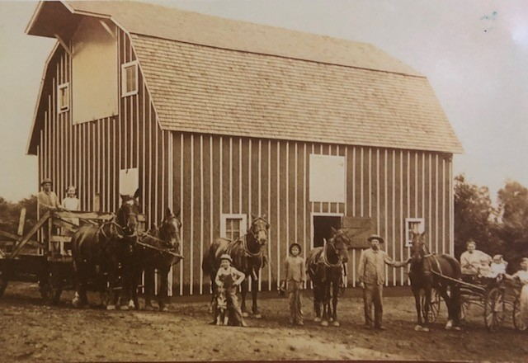
My “why:” 150+ years of Rogge Family Farms

Slide 4
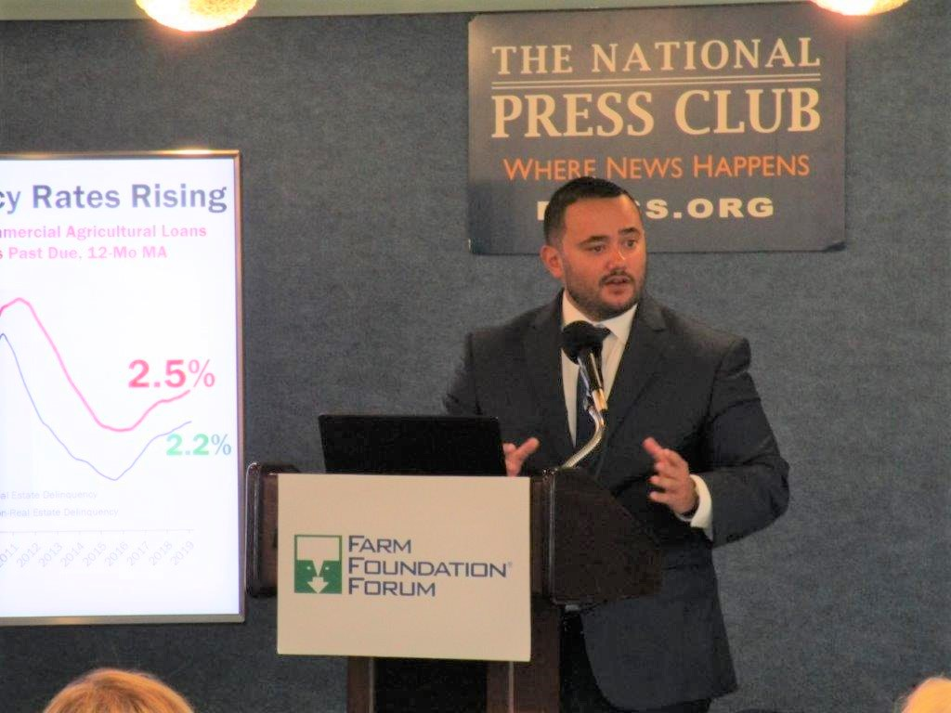
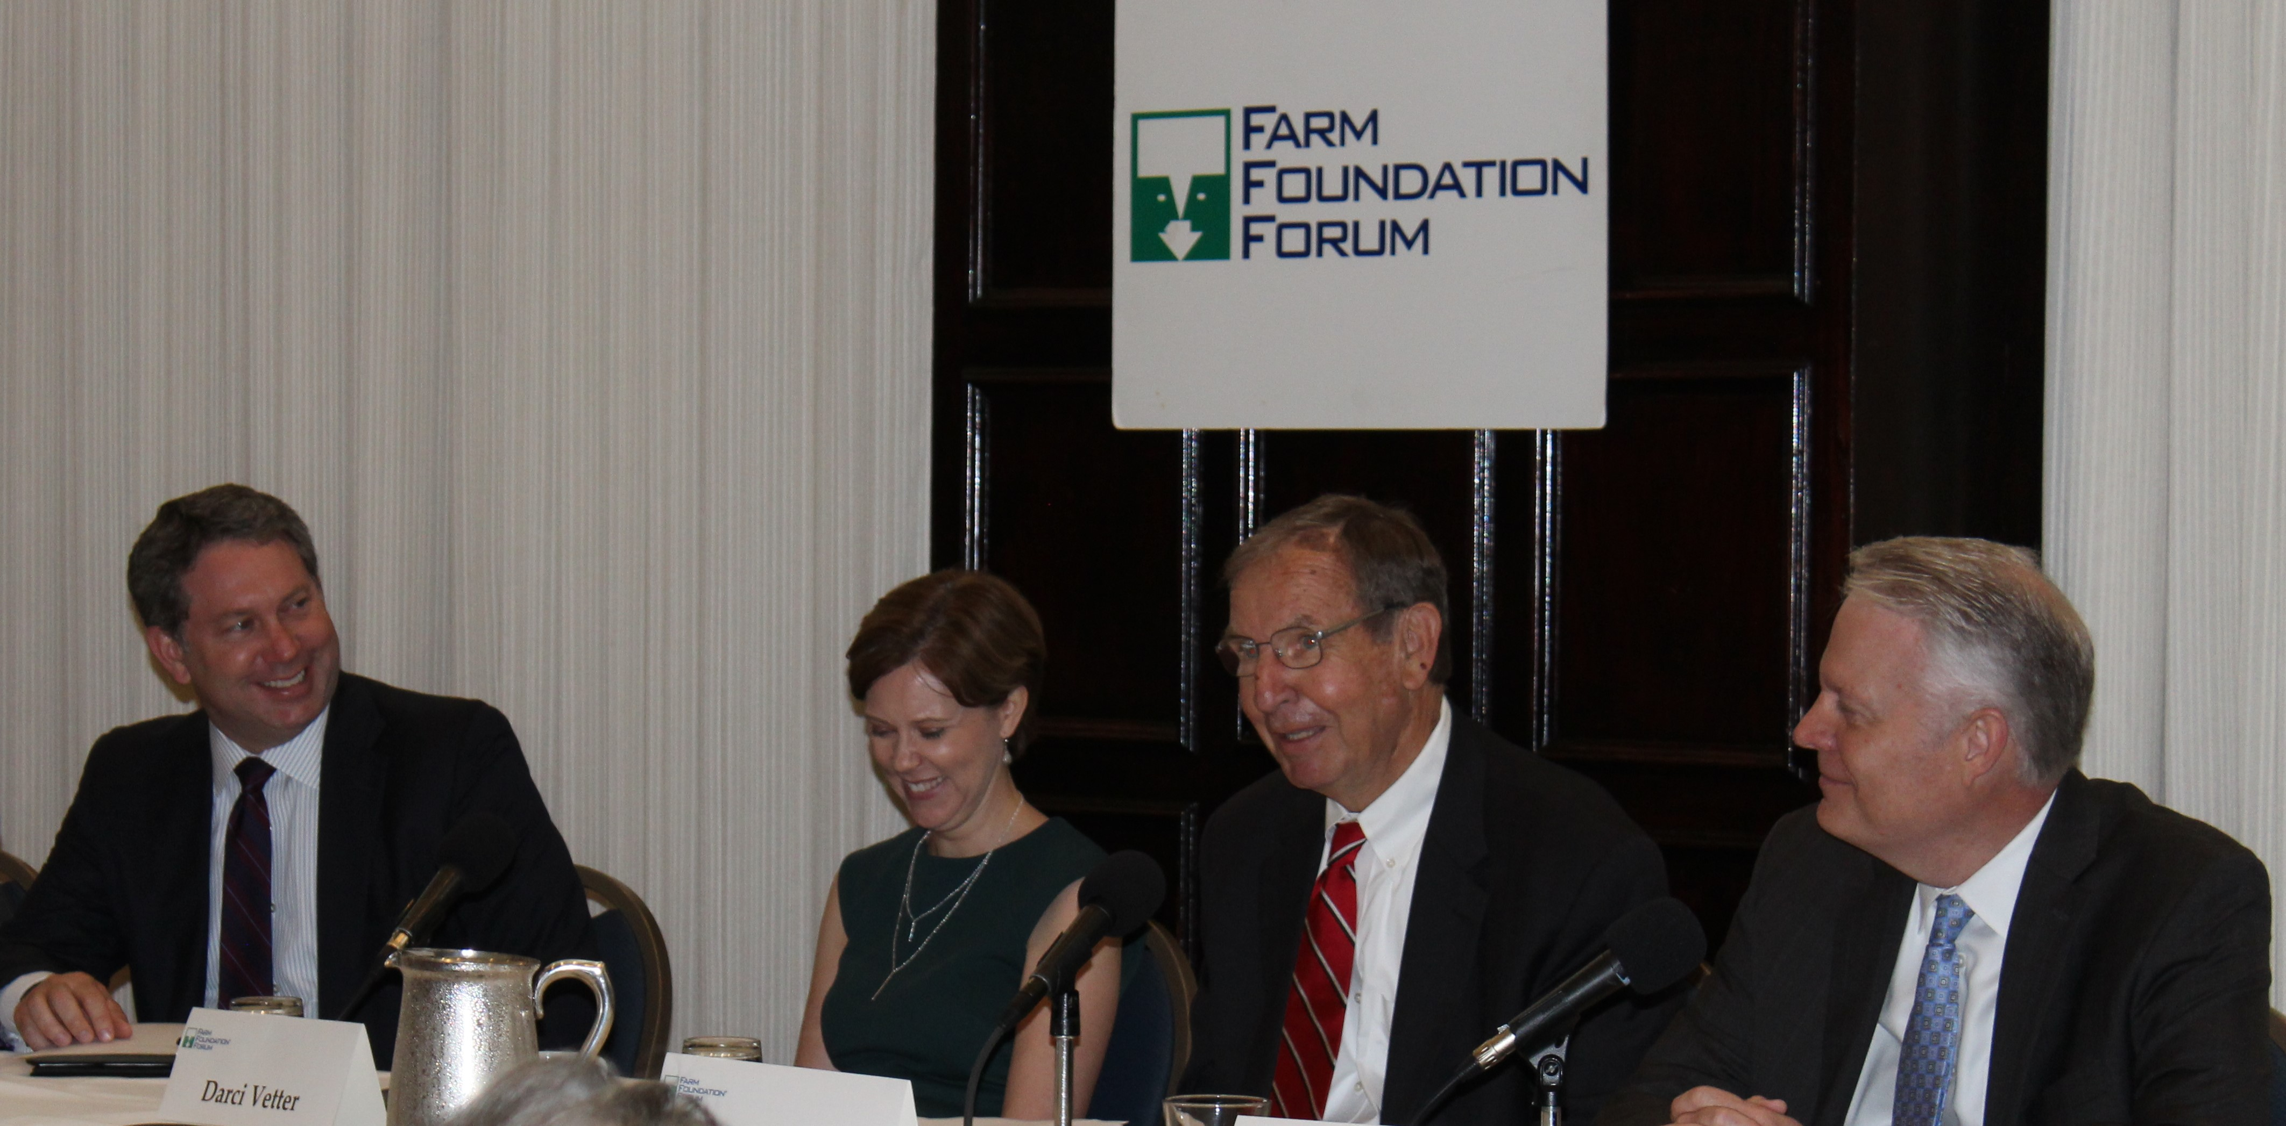
Building trust and understanding at the intersections of agriculture and society
Established after the “Dust Bowl” in 1933
Uniquely positioned as non-partisan, multi-stakeholder across the food system
Objective analysis, dialogue and training
Accelerating ideas into action

Slide 5
Farm Foundation: Next generation programs
Farm Foundation develops and implements programs that help nurture and celebrate the next generation of agricultural leaders.
Cultivators
Agricultural Scholars
Congressional Fellows
Young Farmers
Young Agri-food Leaders

Slide 6
Challenges Farmers Face

Slide 7
Key challenges farmers face
What farmers talk about….
What farmers think about…
Weather
Production
Family/ Legacy
Health
Economics/ Financial
Labor
Markets
Rural Communities
Lawsuits
Consumers

Slide 8
Primary focus of innovation
Labor
Economics/Financial
Polarization/Trust
Infrastructure
Environmental
Policy/Regulations
Health/Safety
Trade
Rural Communities
Legacy/Family

Slide 9
Innovation Explosion

Slide 10
VC capital fueling innovation
Sources: USDA, AgFunder
Notes:
Agrifood Tech investing has increased dramatically, dwarfing public sector R&D spending, reaching ~$17B across nearly 1,500 deals in recent years (2018).

Slide 11
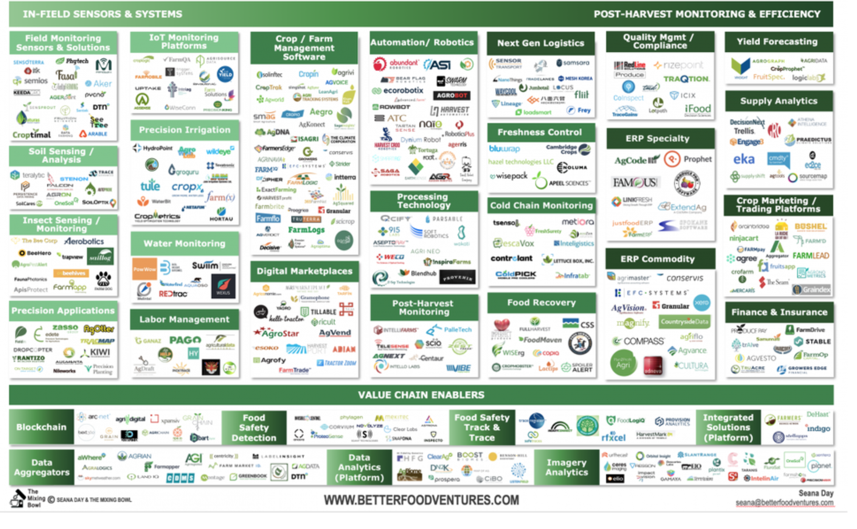
Explosion of innovation
Granular
Conservis
CropX
Hortau
FBN
Indigo
Sources: The Mixing Bowl, Better Food Ventures

Slide 12
Adoption rates increasing
Sources: USDA, ERS

Slide 13
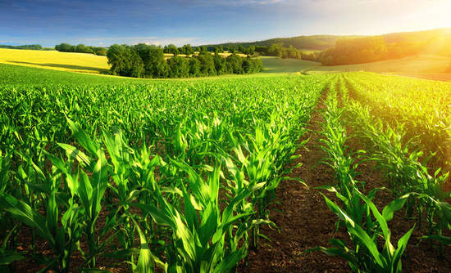
Case study: Row crops
Precision ag—input management/ resource management
Digitization/data management
Biologicals
Breeding resilient strains for drought and flooding
Source: Iowa Soybean Association
Notes:
Precision Ag – biggest adoption rates, in the 80-90% range
Farm Foundation engages with both organic and conventional row crop growers who are adopting many of these innovations.
On the organic side, Klaas Martens, one of our board members and organic farmer in NY (??) says that they use RTK GPS and camera guidance equipment. His operation uses it for 2 in row spacing

Slide 14
Klaas Martens, New York organic producer
“Our farm has sloping soils that drain into Seneca Lake. Erosion can only be controlled by narrow contour strips, diversion terraces, cover crops and reduced tillage. While narrow strips can be challenging, we gain other advantages such as pest management.
We use RTK GPS to keep strip boundaries exact. The near perfect spacing allows us to manage crops without weed issues. Our camera guidance systems work precisely so that we can use finger weeders to remove weed seedlings from within the narrow rows. These technologies enable us to work much faster and effectively.”

Slide 15
Case study: California produce
Labor/mechanization/robotics
Genetics—drought resistant/ resilient seeds
Data/smart labels/blockchain
Resource management
Source: Interviews, CNBC, Agrobot
Notes:
AG Kawamura, CA producer and FF board member: On the economics of innovation adoption for produce
“In California, the rapidly rising minimum wage rates and work-hour limitations forcing farmers to move to an 8 hour, 5 day work schedule is creating a non-competitive disadvantage for procdercer in a martket place that is not adjusting upwards for these added costs. We are looking at accelerating mechanization as the only remaining option to remain competitive.”

Slide 16
A.G. Kawamura, on mechanization and robotics
“In California, the rapidly rising minimum wage rates and work-hour limitations create a non-competitive disadvantage for producers in a marketplace that is not adjusting upward for the added labor costs.
We are replaceable suppliers of fruits and vegetables, regardless of our “locally grown” promotions. So we are looking to mechanized harvest as the only remaining option to remain competitive due to our labor costs.”

Slide 17
Case study: Indoor agriculture
New indoor and vertical farming systems
Controlled environments for animals, produce, aquaculture
Often reduced inputs and closer to markets
Evolving entrepreneurial options for some farmers and rural development
Source: Dirt-to-Dinner

Slide 18
Innovation as a Solution?

Slide 19
Innovation as solution or disruptor for farmers?
Five signs of industry disruption:
Changing customer preferences
Declining loyalty/revenue
Increased VC/investment
Profit pressure
New entrants/new models
Sources: STIM, Statista

Slide 20
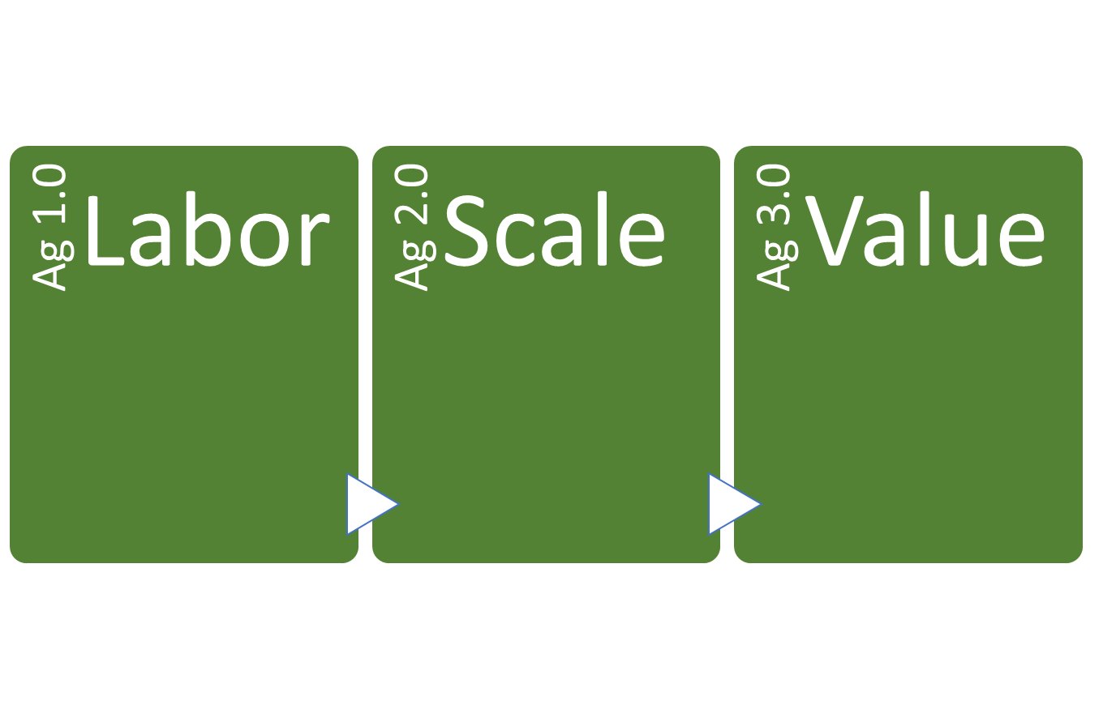
Ag 3.0: We are entering a new era
Defined by creating and capturing value through new ways
Transformation and change can be messy.
How can we help each other navigate these changes?
Notes:
Ag 1.0 Early 20th century, intensive labor, 7 m farmers, 30% of population
Ag 2.0 1950-2000, efficiencies, focus on lowering costs, higher volumes…scale, down to 2 m farmers. Consolidation is a fact now rather than a vision. There are multiple viable strategies for success, including obtaining more economies of scale through size. However, increasing the size of operations alone will not be enough.
Ag 3.0 Move towards capturing more profit, more value capture up and down the value chain through partnerships, branding, etc., new skills. Will continue to lose farmers…how low will we go? 1 m? What do we as a society value? How can farmers position their operations for success in this future?

Slide 21
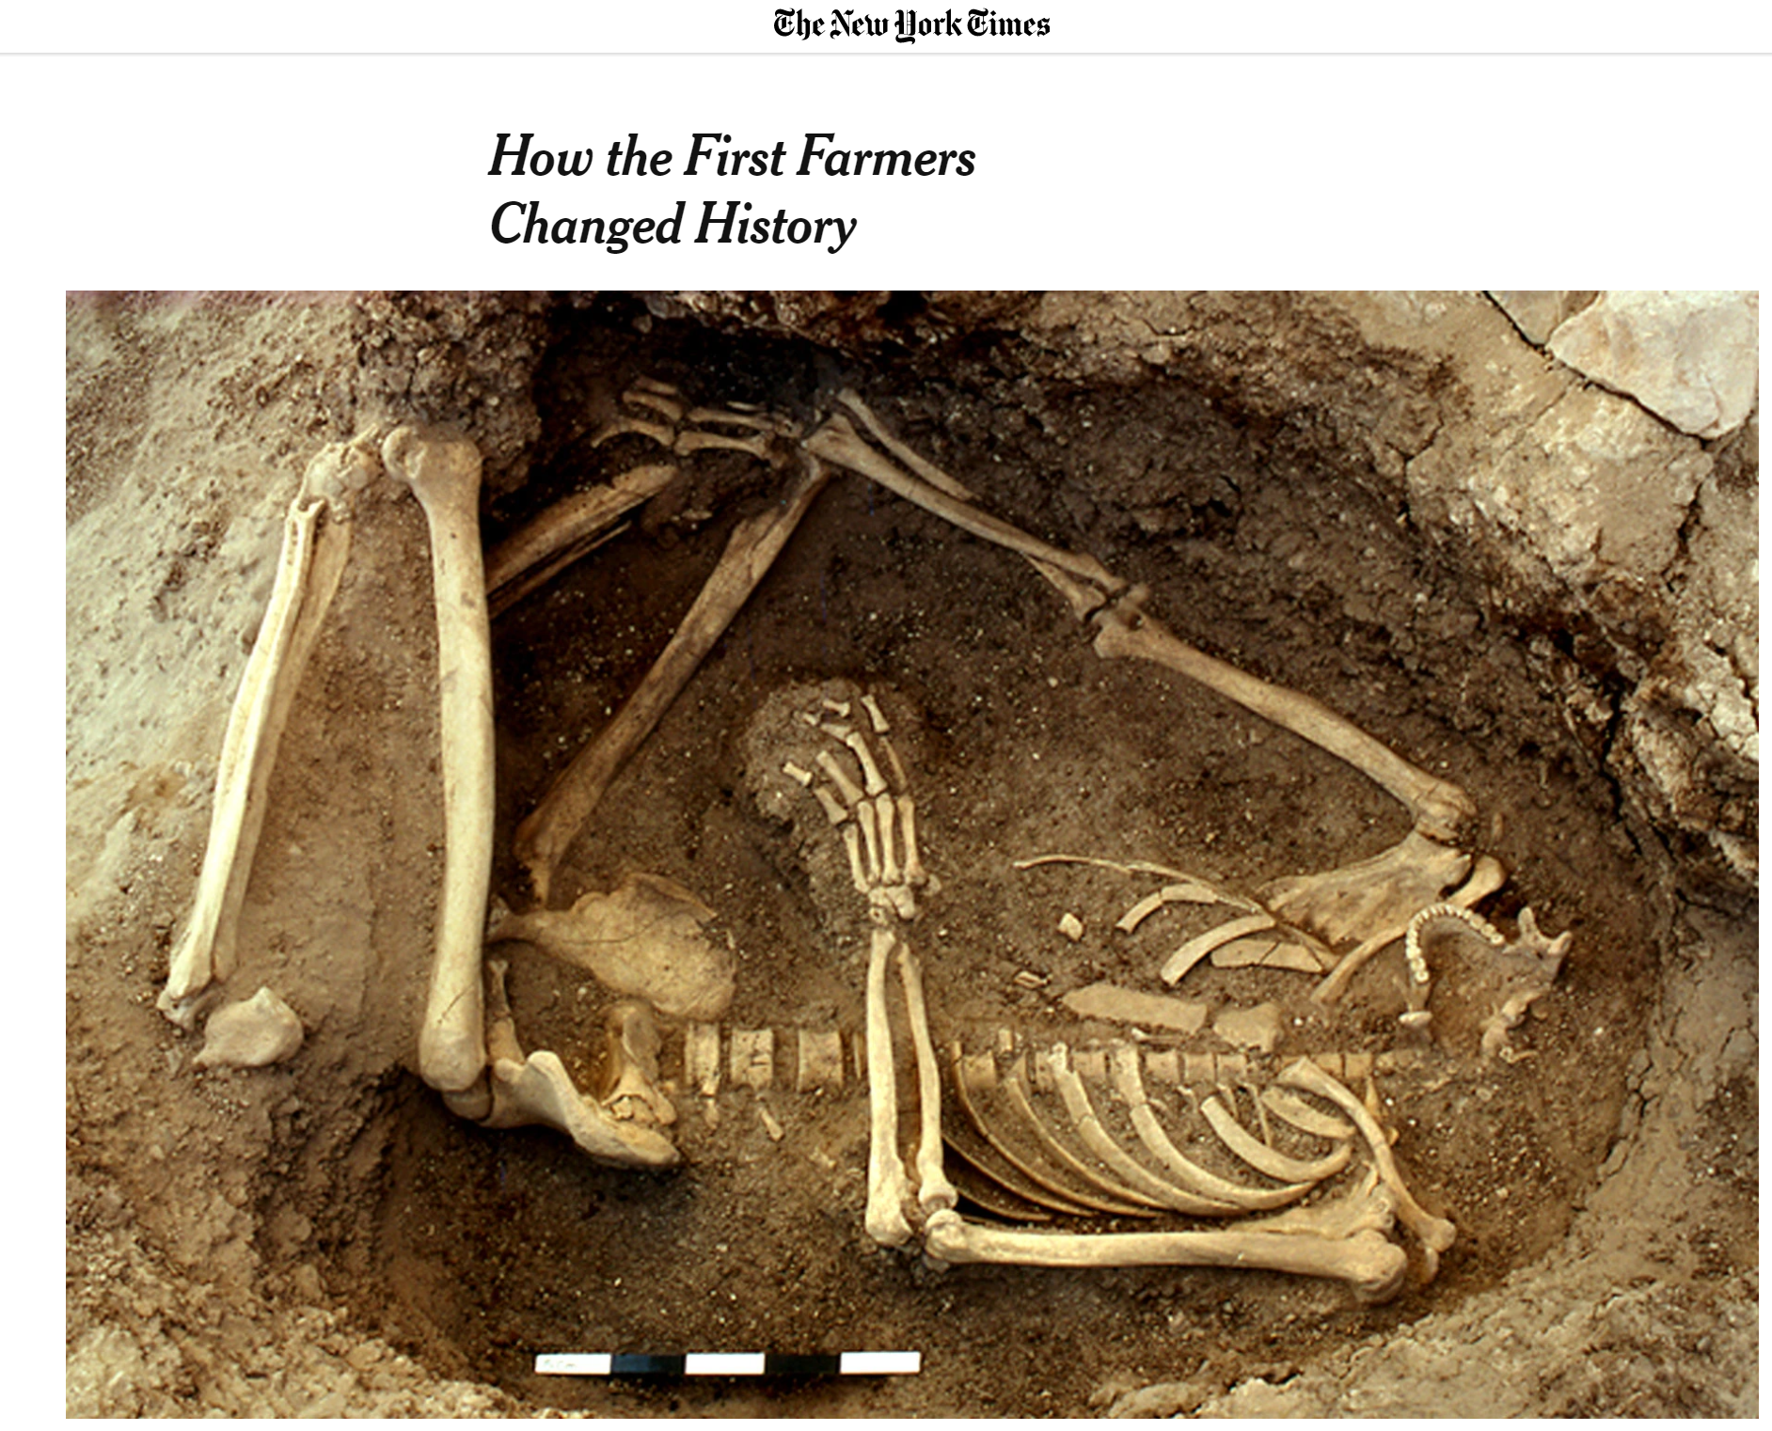
Farmers as innovators and co-creators of the solutions!
Discovered farming: 10,000-20,000 years ago
…and innovating now!

Slide 22
Collaborating for successful innovation
What role do we see for farmers and rural communities in our future?
How can we partner with farmers to navigate this era of disruption and transformation successfully?
How can we innovate to help solve some of the other challenges farmers face that don’t necessarily come from technology?

Slide 23
Invitation to collaborate
Join Farm Foundation and others to collaborate for improved understanding and positive transformation:
National Press Club Forums—March Forum on gene editing
Digital Ag and Beginning Farmers workshops
NextGen programs—help us connect with diverse candidates
Shaping our next “big idea” for innovation—share your thoughts!
Say hello to our Ag Scholars while you are together here!
Building a future for farmers, our communities and our world!

Slide 24
Connect with us: farmfoundation.org
@farmfoundation @thefarmfoundation @farmfoundationorg @thefarmfoundation Farm Foundation

