Slide 1
Ambassador Kip Tom
February 20, 2020

Slide 2
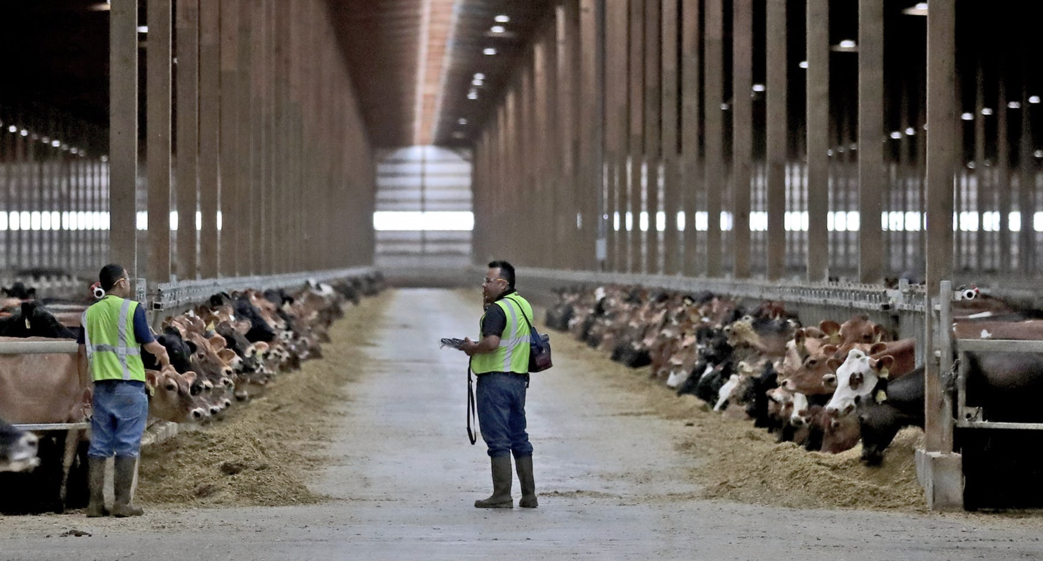
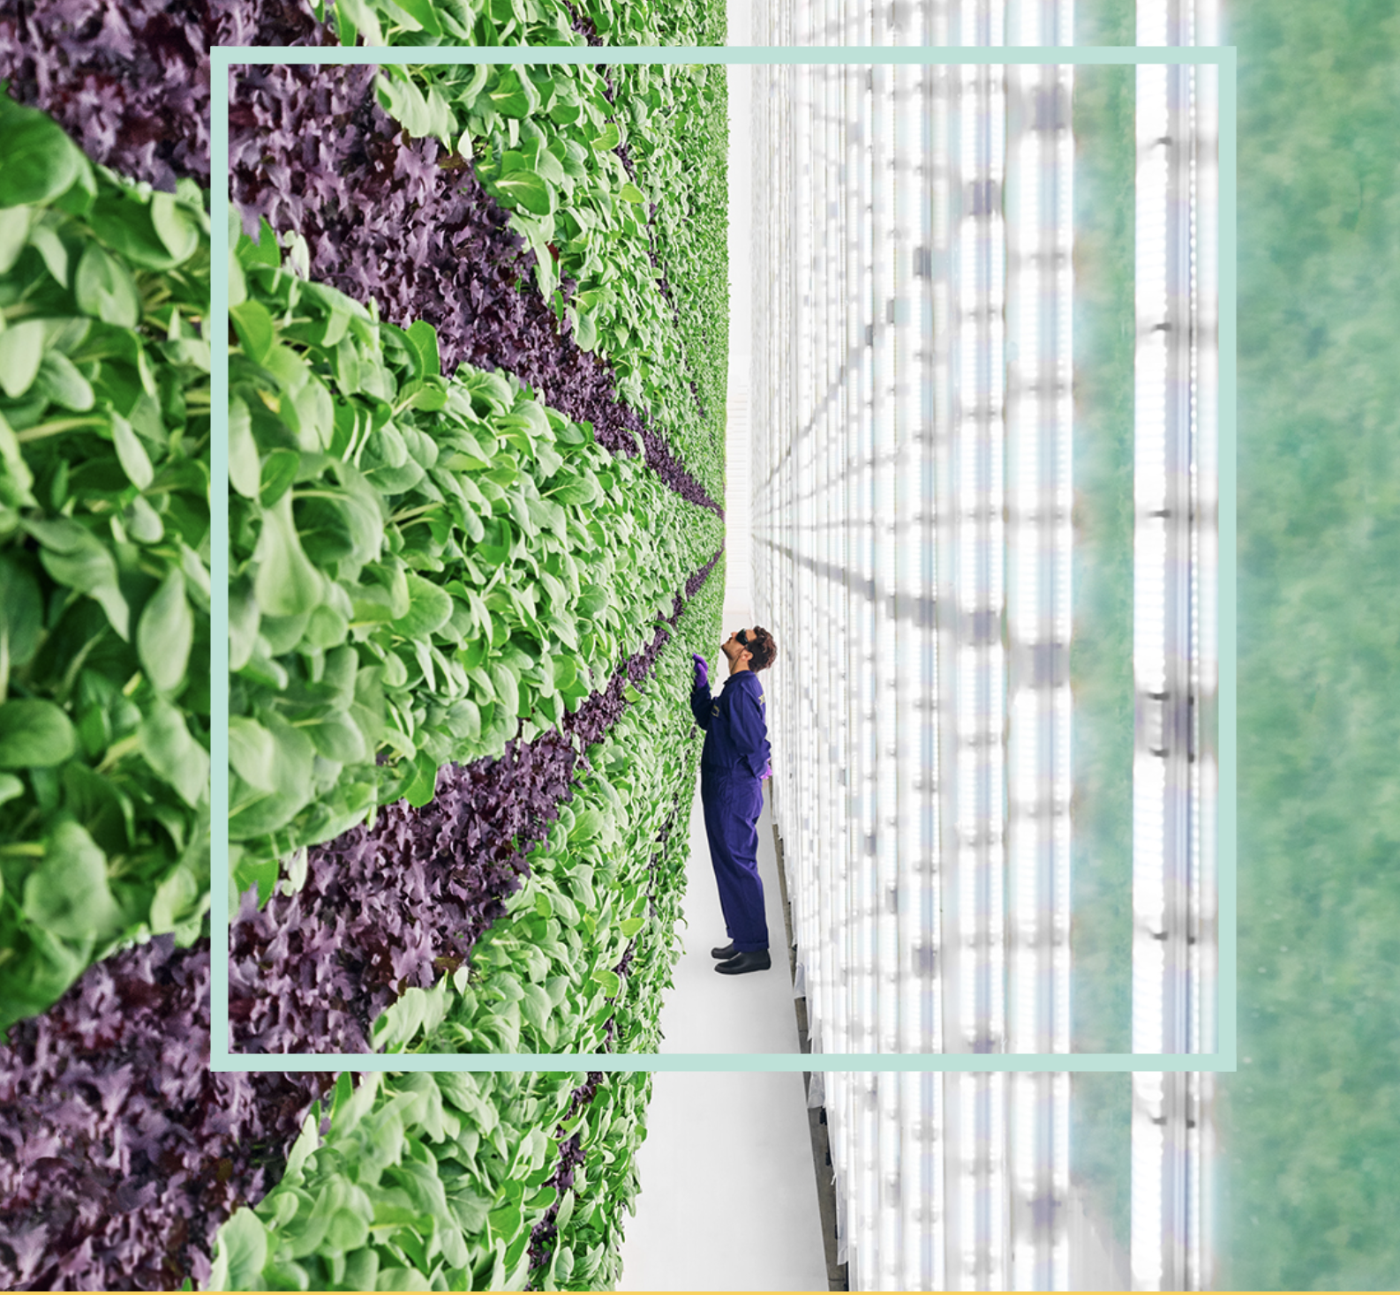
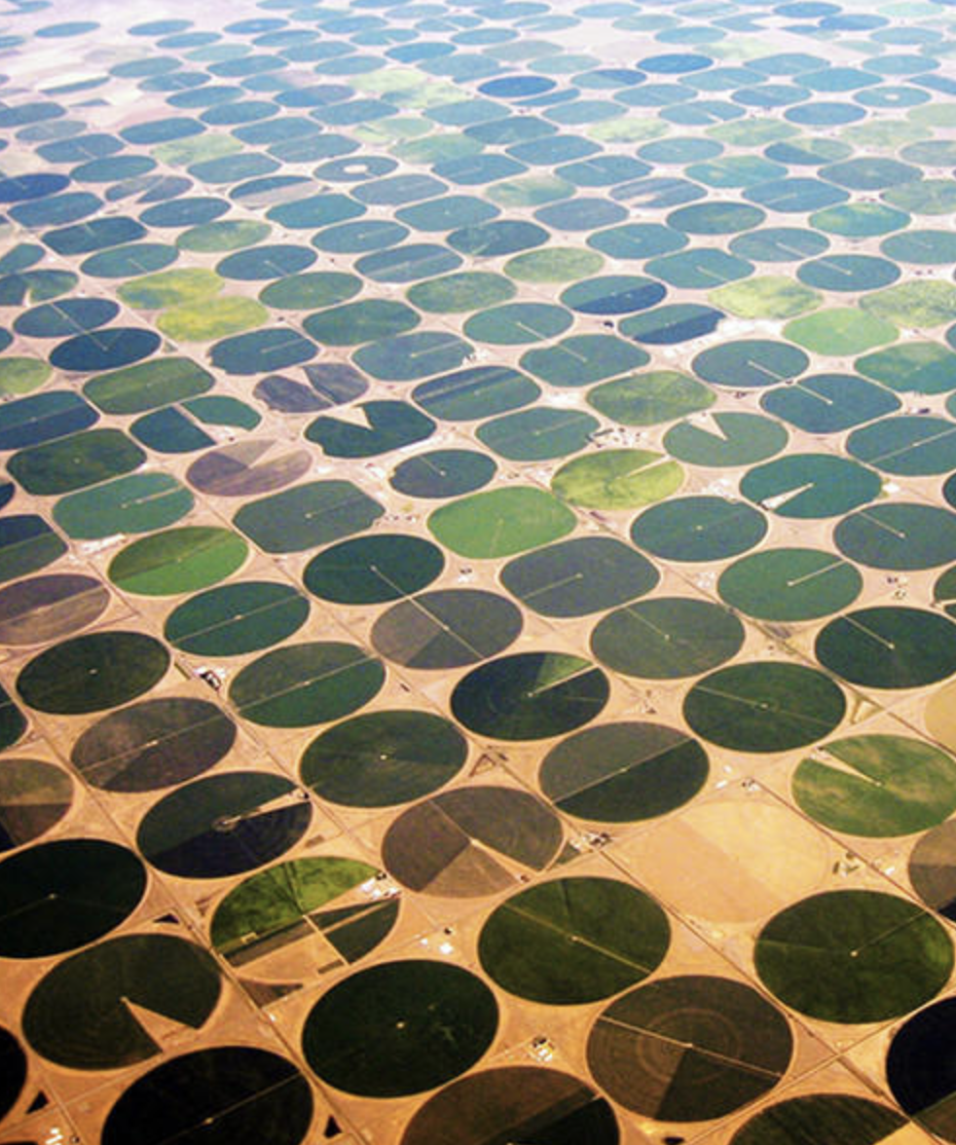
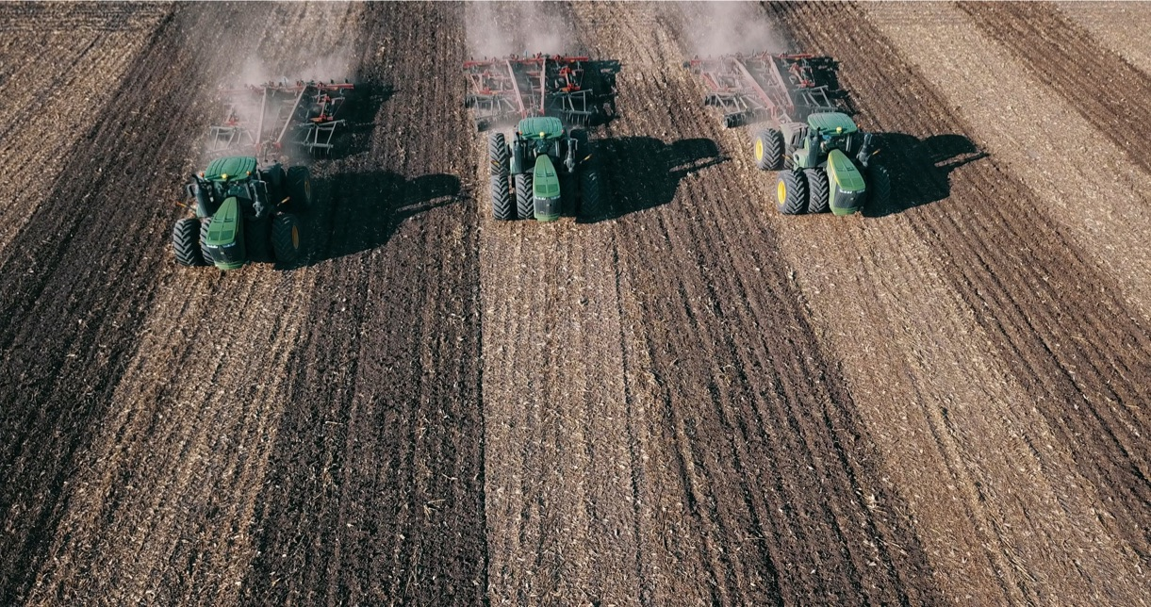
Notes:
American farmers

Slide 3
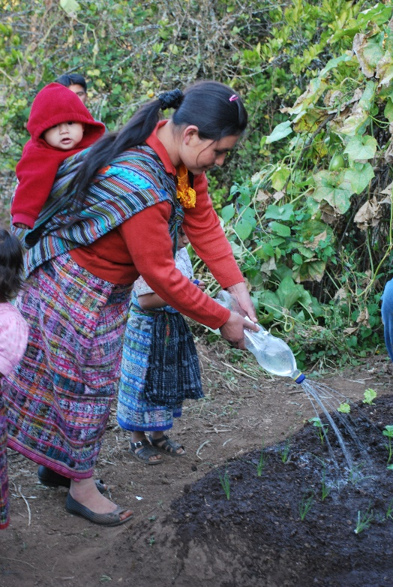
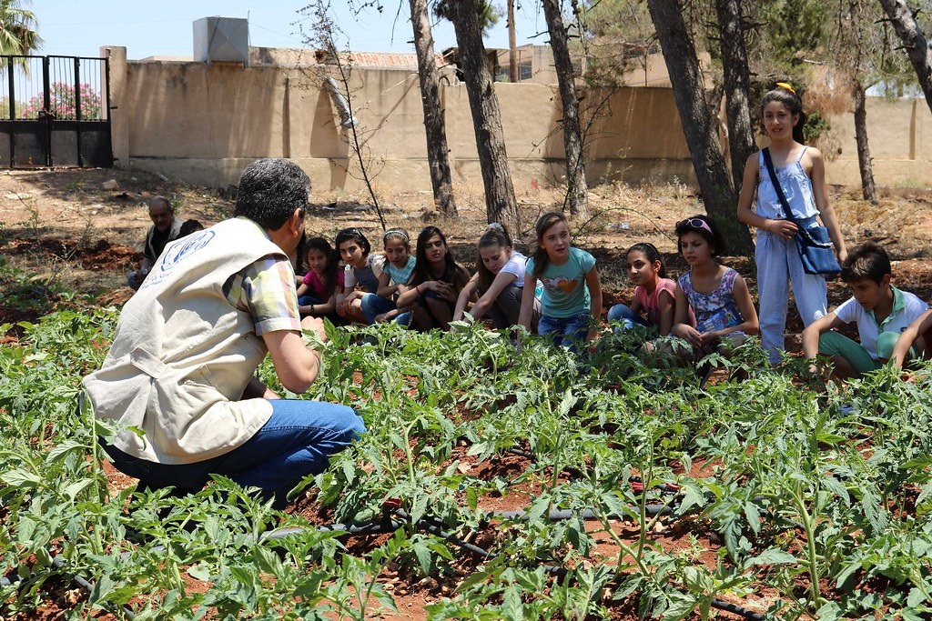

Slide 4
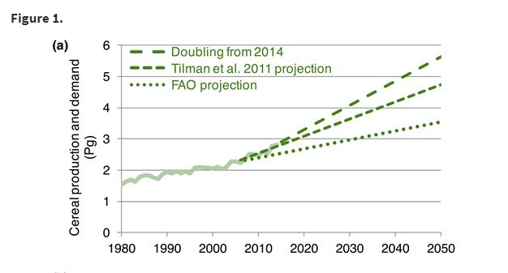
Food production needs to increase 25-70% by 2050
Source: Bioscience

Slide 5
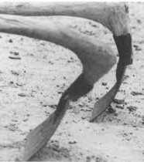
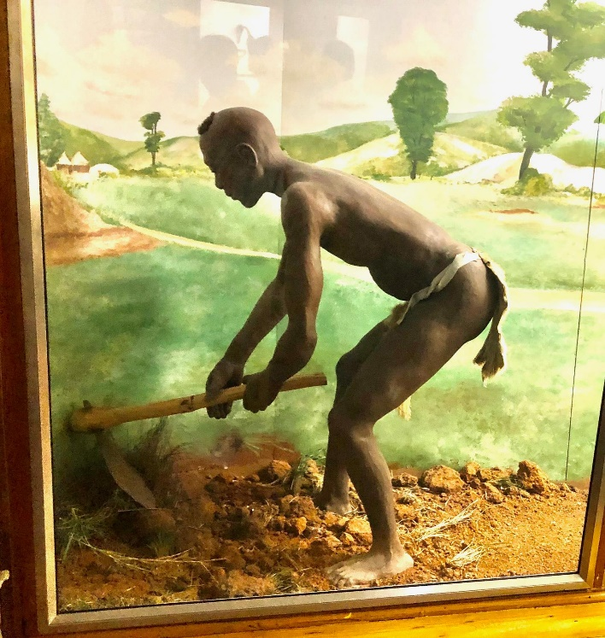
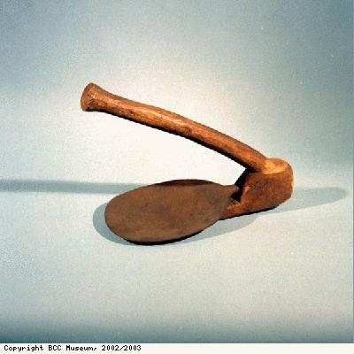
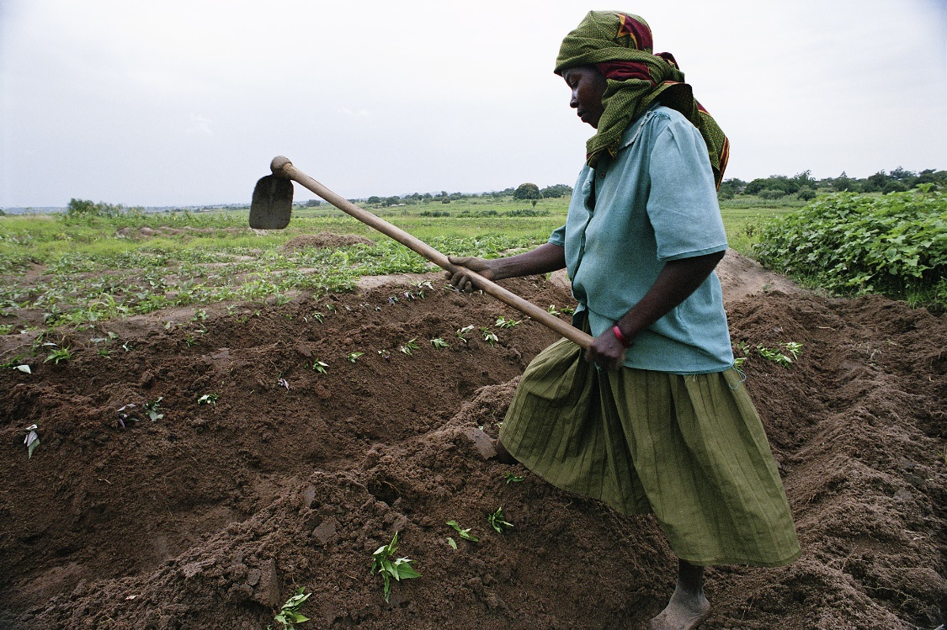
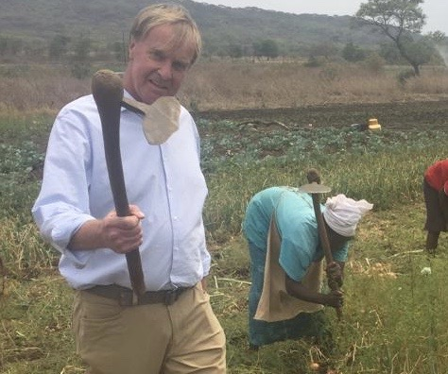
Farming in 800 B.C.
Farming in 2020 A.D.

Slide 6
Desert Locust Outbreak-Africa
Estimates by officials of swarms consuming 1.75 million metric tons of green vegetation per day in Eastern Africa.

Slide 7
Notes:
WFP hunger map

Slide 8
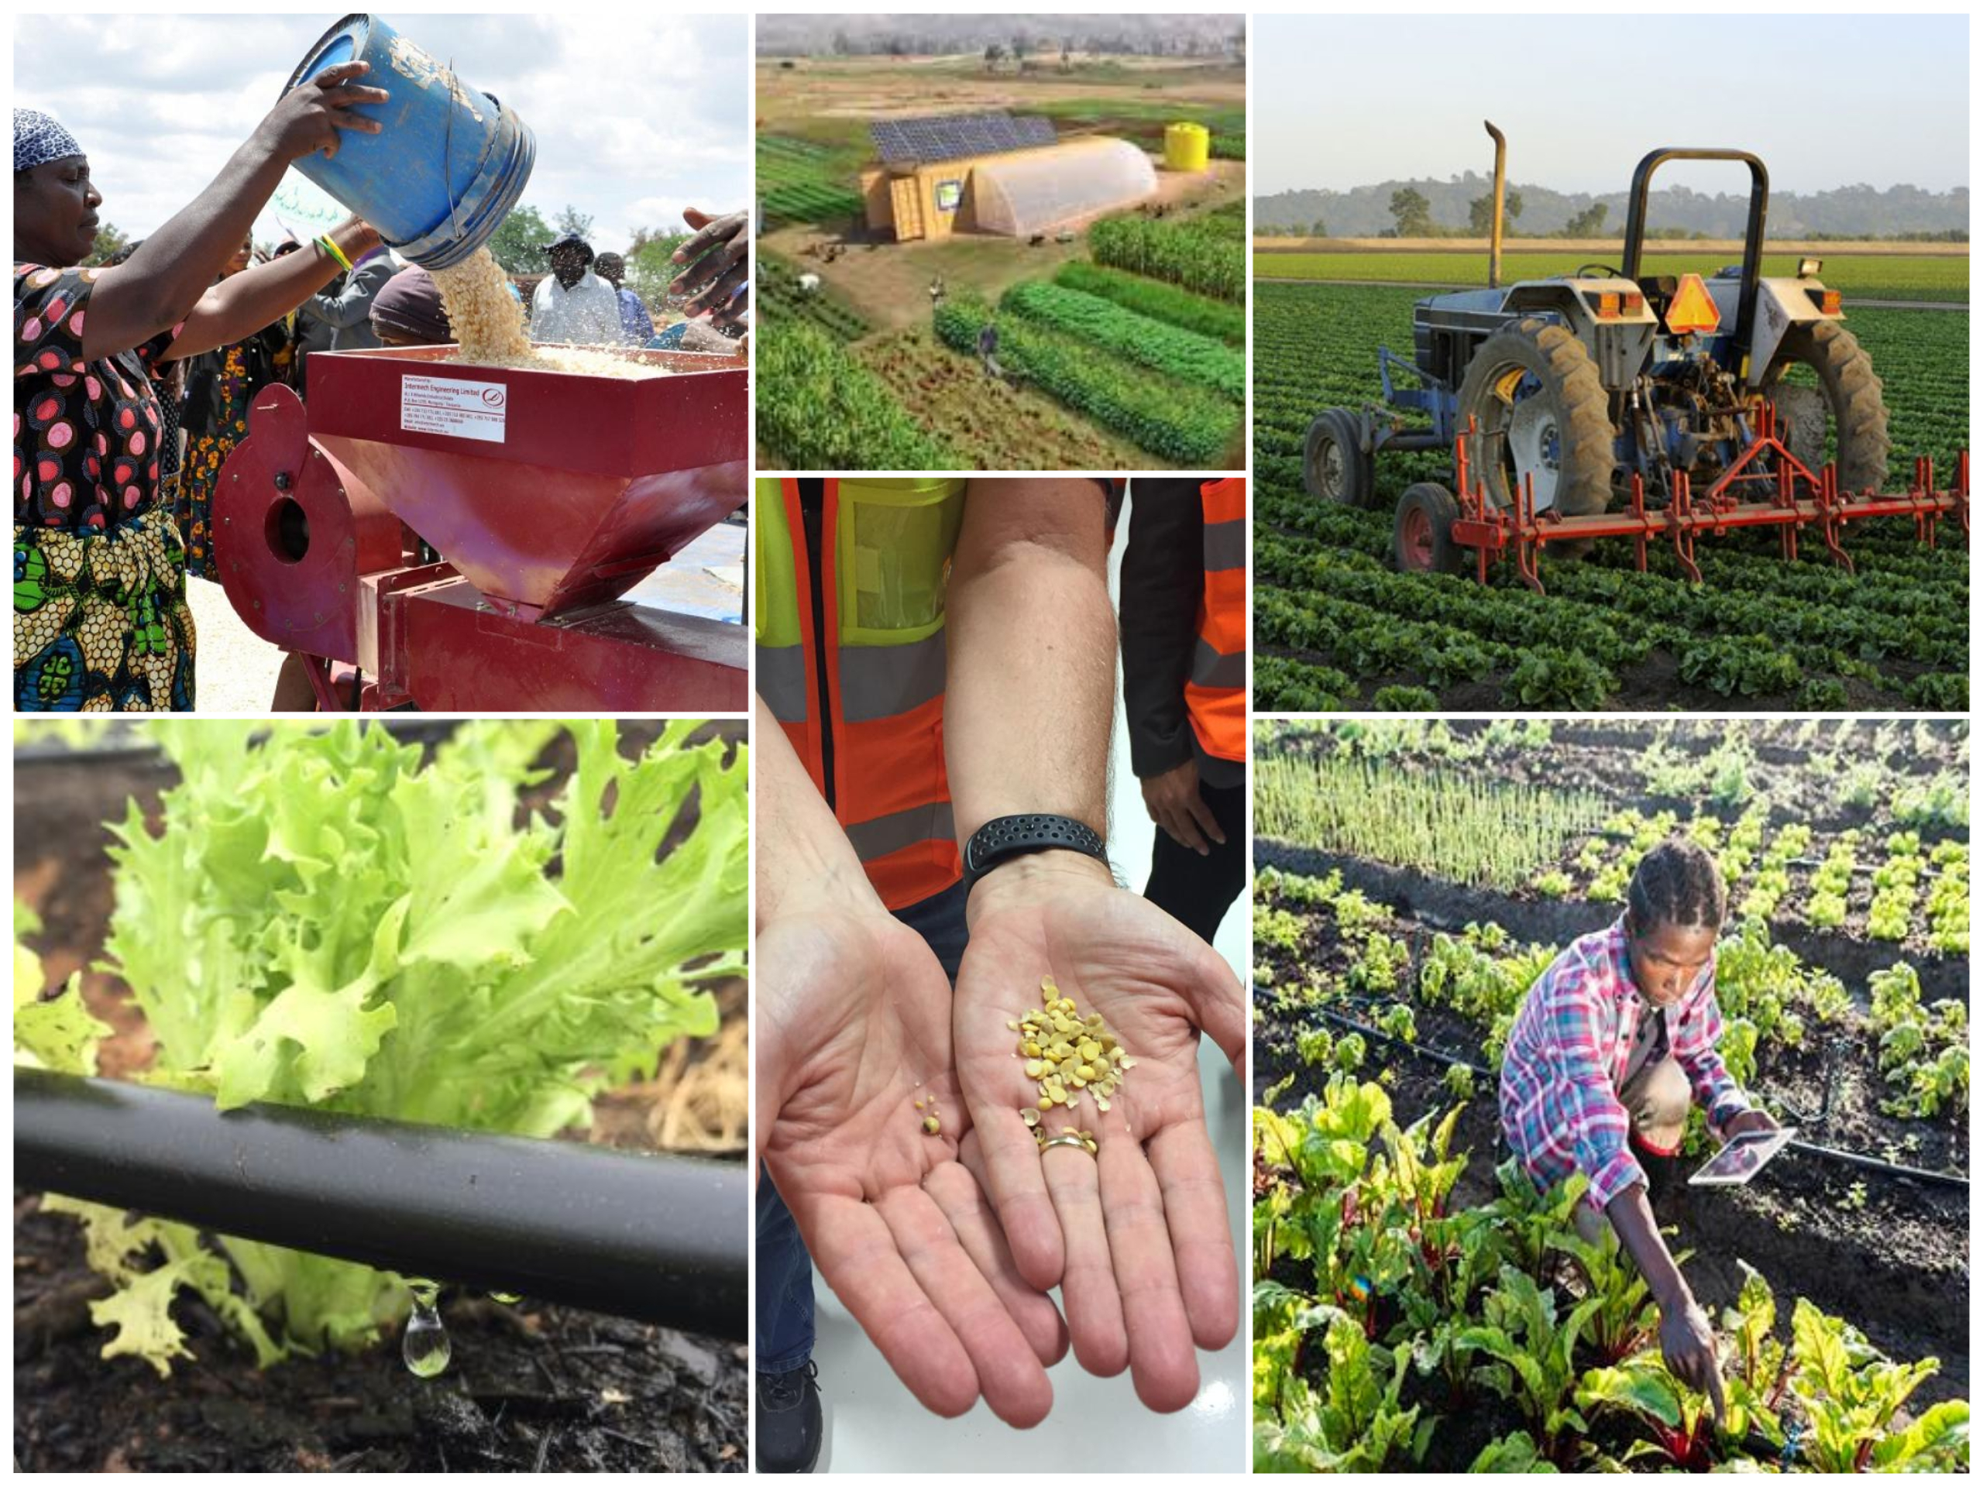

Slide 9
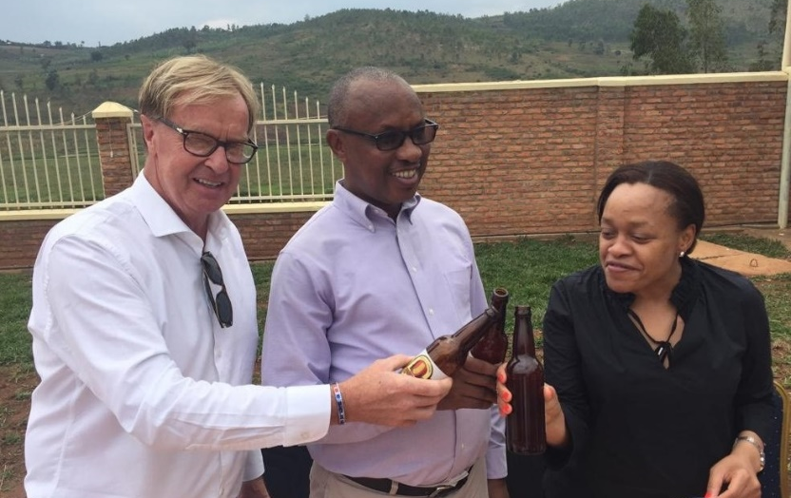
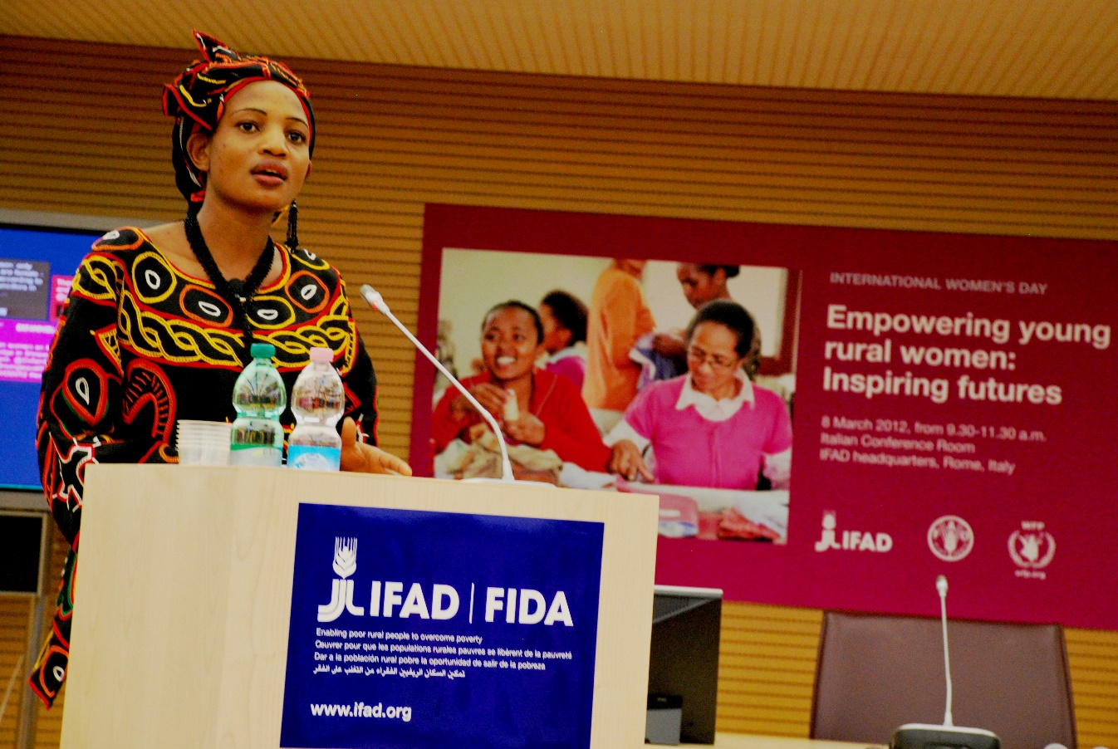

Slide 10
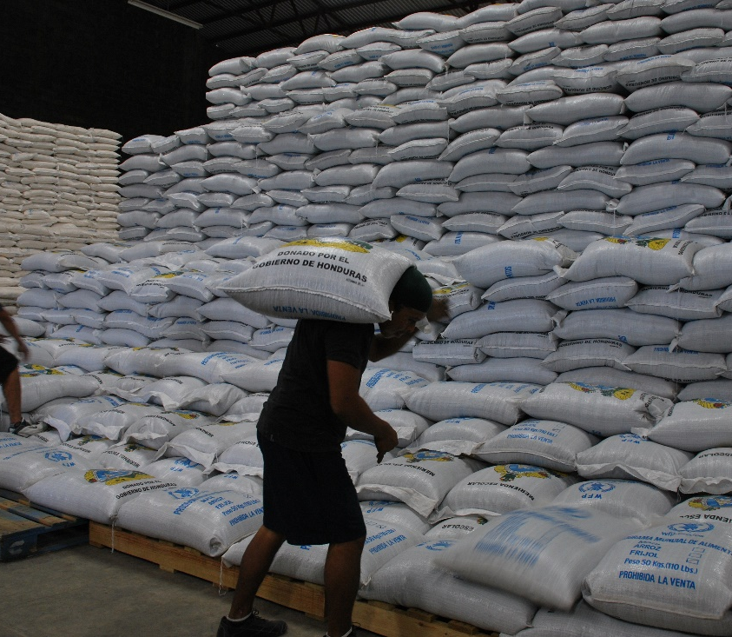
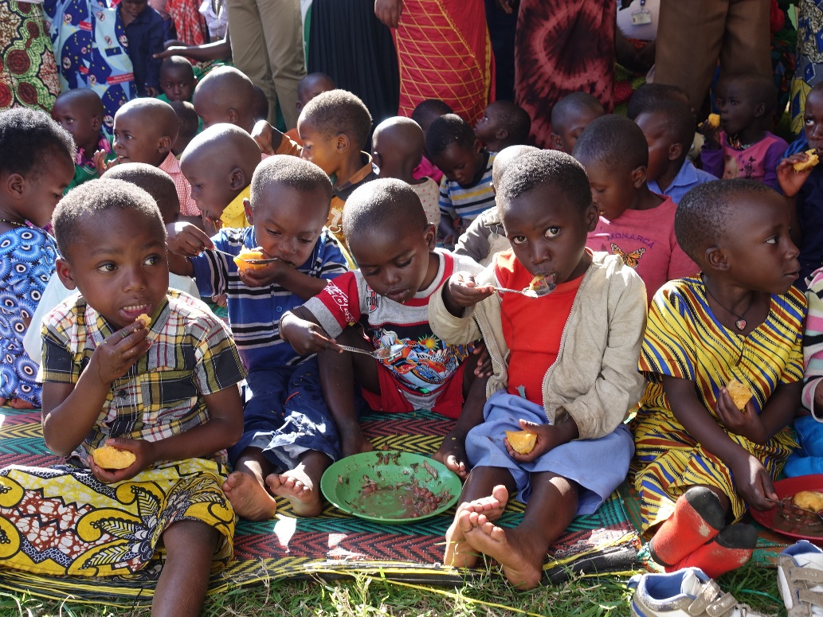
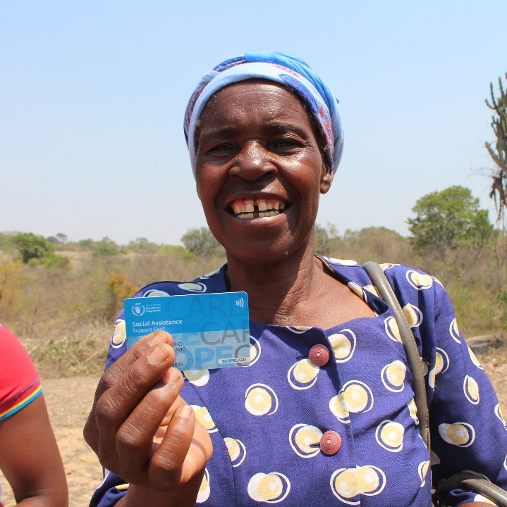
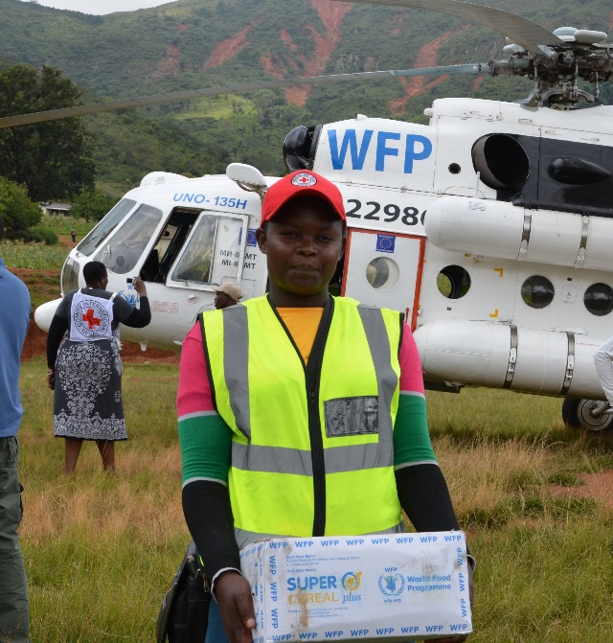
Notes:
WFP 2

Slide 11
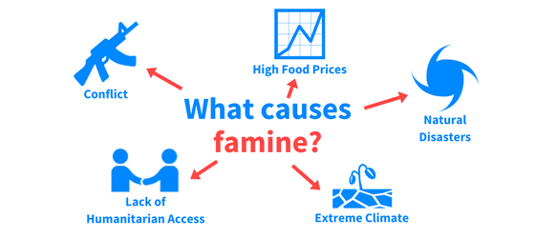
No Access to Innovation

Slide 12
Resource Optimization
Mechanization
Carbon Sequestration
Women Empowerment
Saving Lives and Changing Lives
Ending Forced Migration
Cold Supply Chains
Environmental Services
Livelyhoods
Youth Engagement
Infrastructure
Farmer Education
Nutrition and Health
Remote Learning
Ending Smallholder Farmer Cycle of Poverty
Biotech
Food Security
Trade
Gene Editing
Economic Opportunity
Orphan Crops
Bio-Diversity
Internet of Things
Connectivity
Coordinated Supply Chains
Whitewave Technology
Block Chain
Cropcare Products
Remote Sensing
Autonomous Vehicles
Precision Technologies
Robotics
Advanced Analytics
Automation
Sensors
DATA SCIENCE
Machine Learning
Crypto Currencies
Variable Rate Application
Farm Management Software

Slide 13
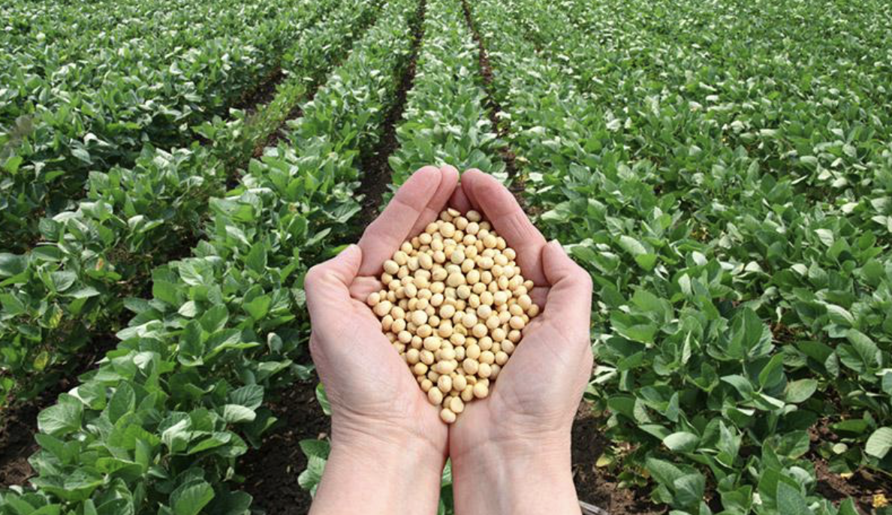
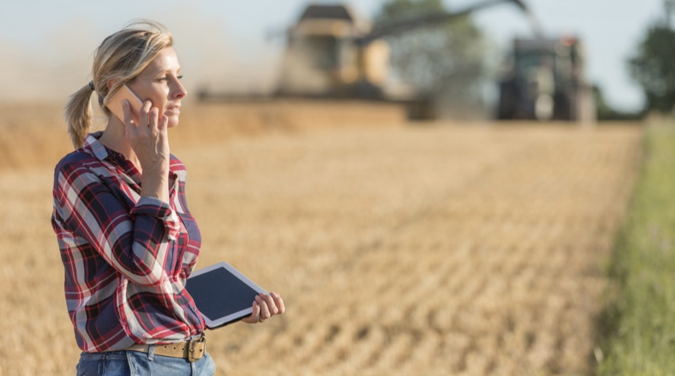
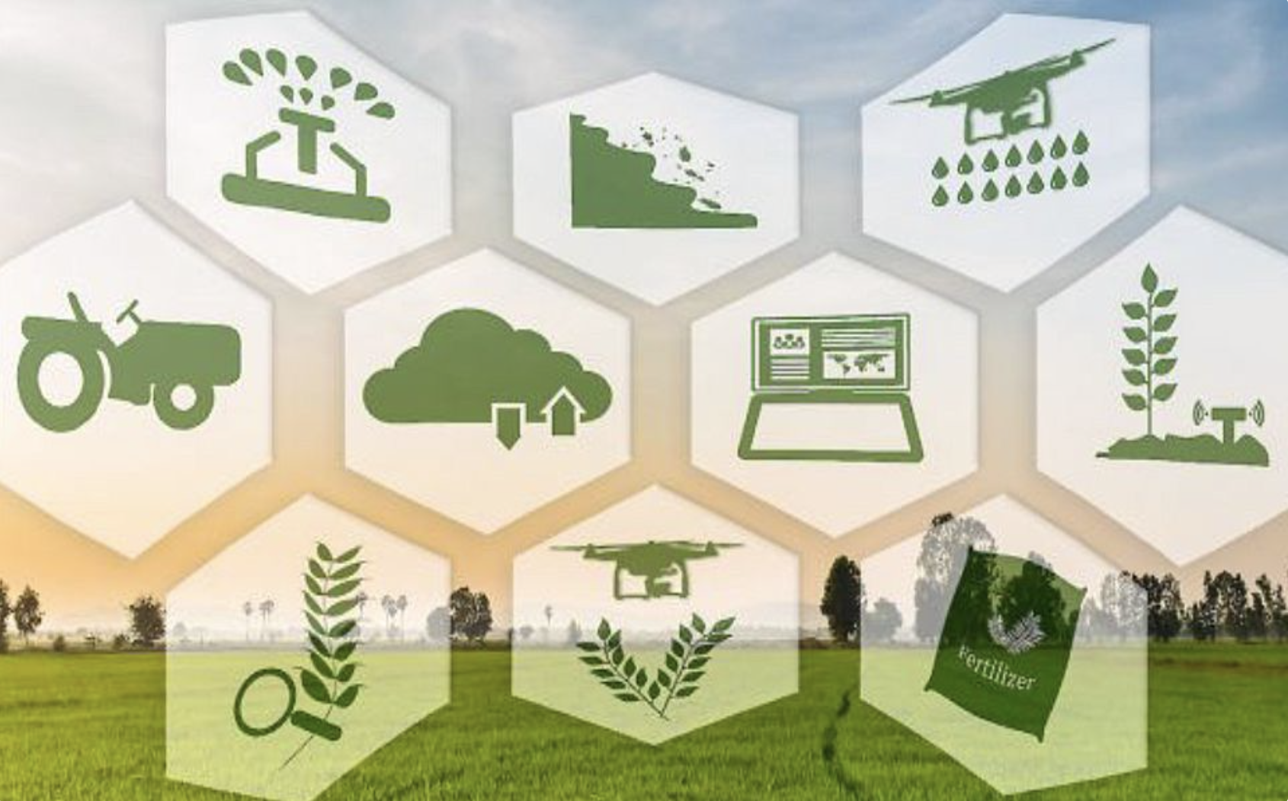
Innovation in Agriculture and Food is the Key to Global Food Security

Slide 15
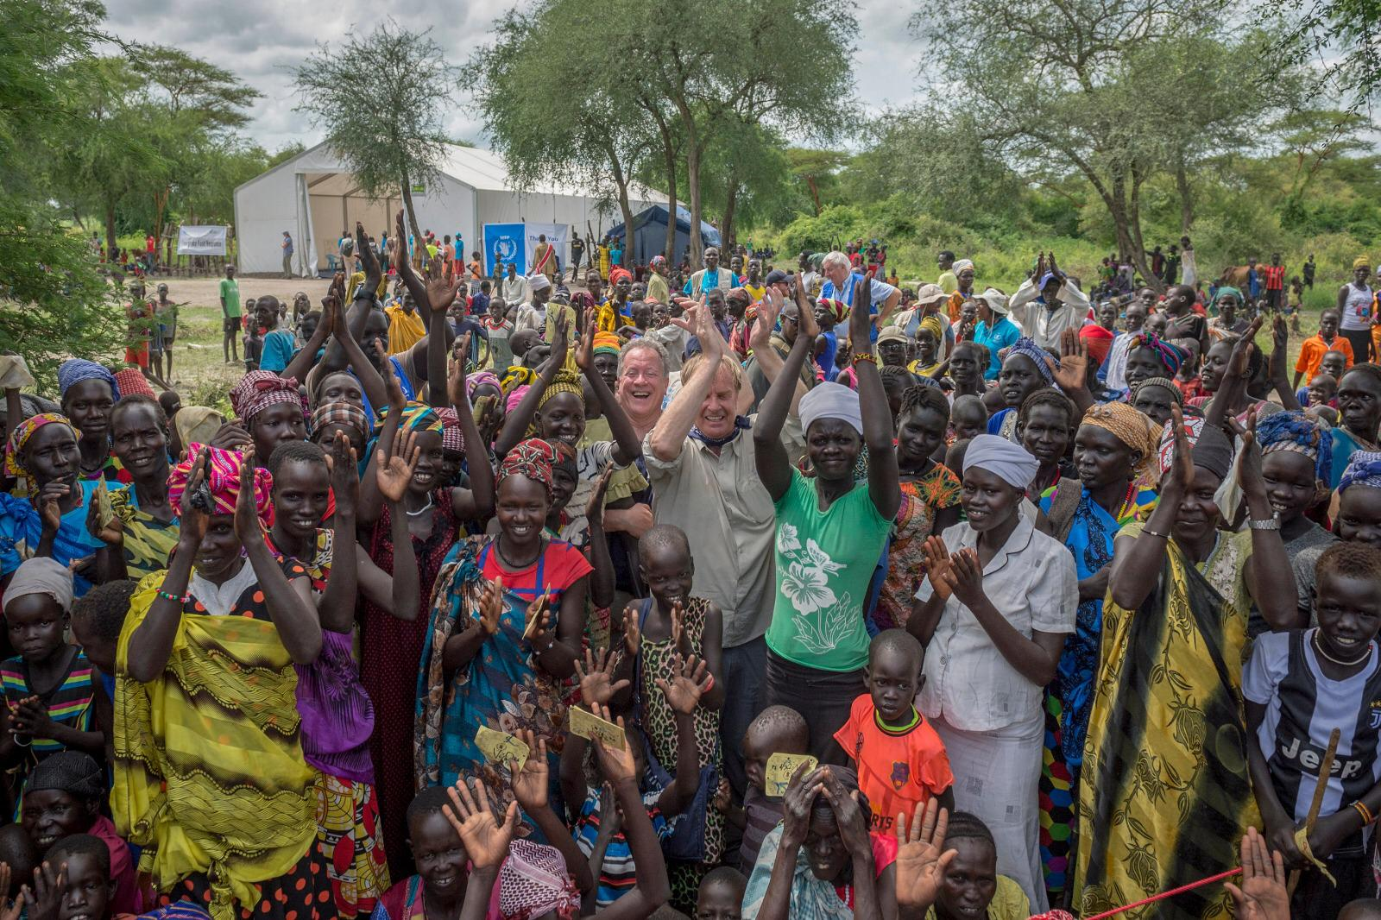
South Sudan IDP Village

Slide 16
Thank You
@USUNRomeAMB

