Slide 1
A Safer, Smarter, and More Digital Food System
Frank Yiannas
Deputy Commissioner for Food Policy and Response
U.S. Food and Drug Administration
@frankyiannasFDA
#smarterfoodsafety

Slide 2
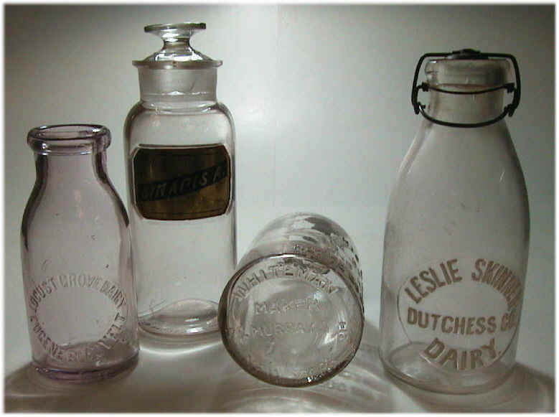
The History of Food Processing
2000 B.C. - Here, eat this food quickly before it spoils.
500 B.C. - That food spoils fast. Here, salt it.
1845 A.D. - That salt tastes bad. Here, place that food on ice.
1850 A.D. - That ice melts fast. Here, place that food
in a refrigerator.
1864 A.D. - That food still spoils. Here, pasteurize it.
1980 A.D. - That pasteurized food doesn’t last long enough. Here, irradiate it.
1997 A.D. - That irradiated food is bad for you. Here, eat this “all natural fresh” stuff.
2000 A.D. - That “all natural fresh” stuff goes bad.
Here, eat this food quickly before it
spoils.
Copyright © 2005 Yiannas

Slide 3
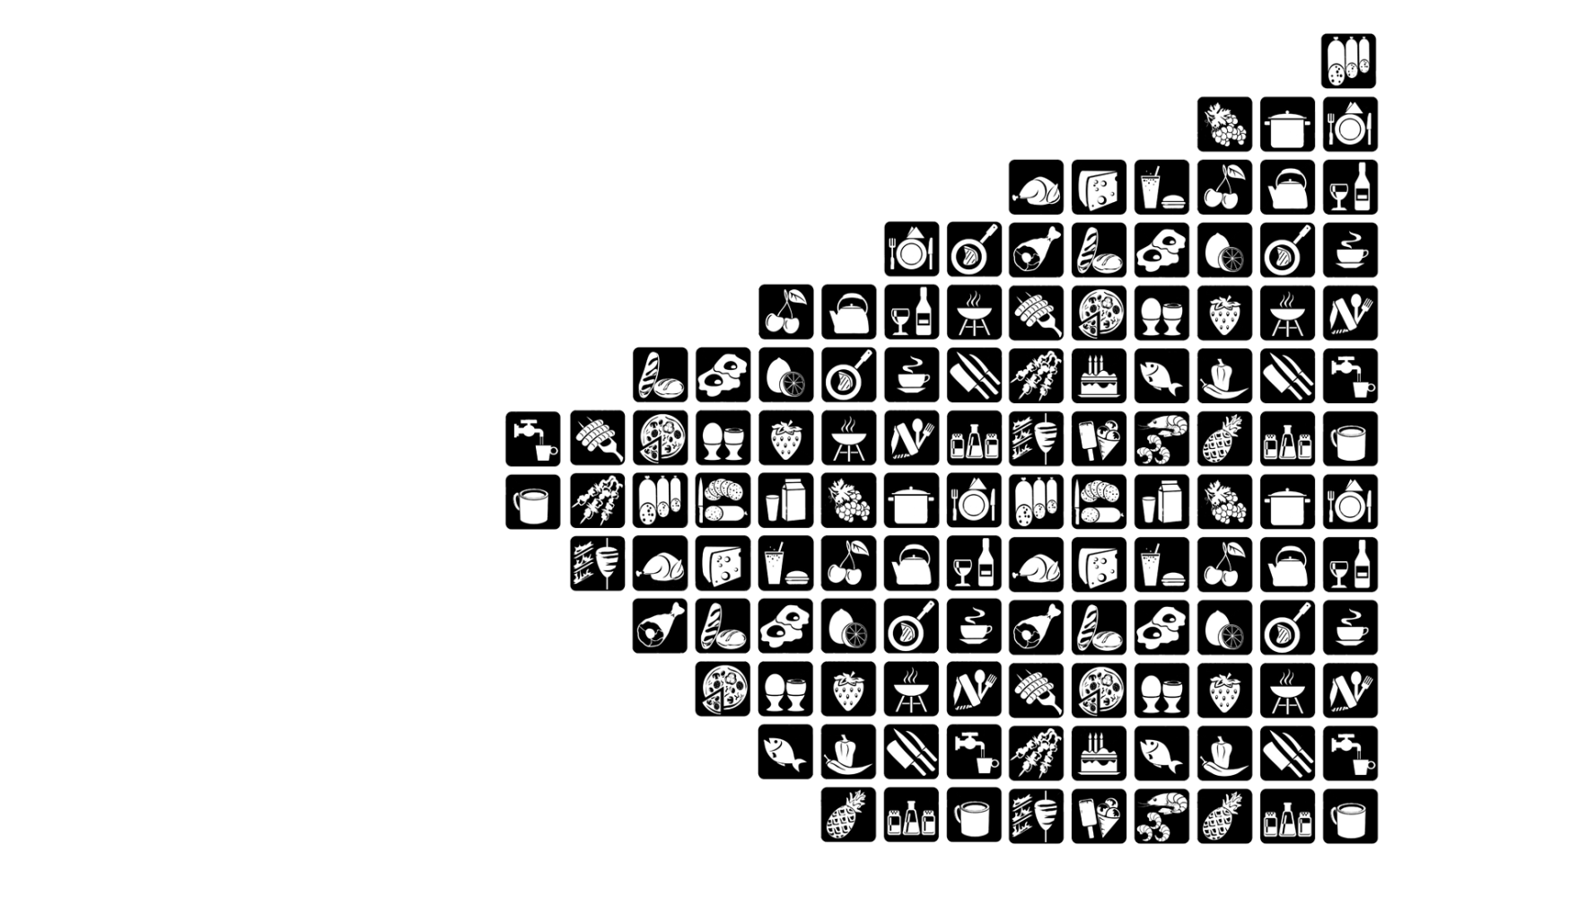
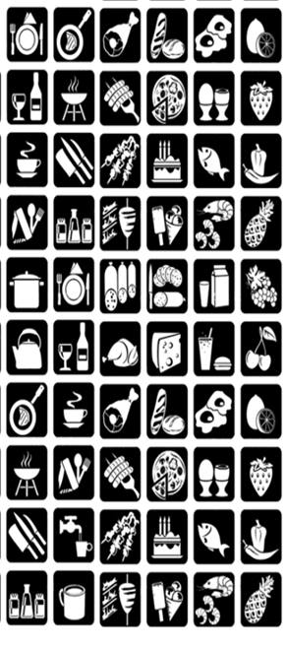
Food System is Changing
endless shelf
50,000
15,000
1980s
2000s
2020s

Slide 4
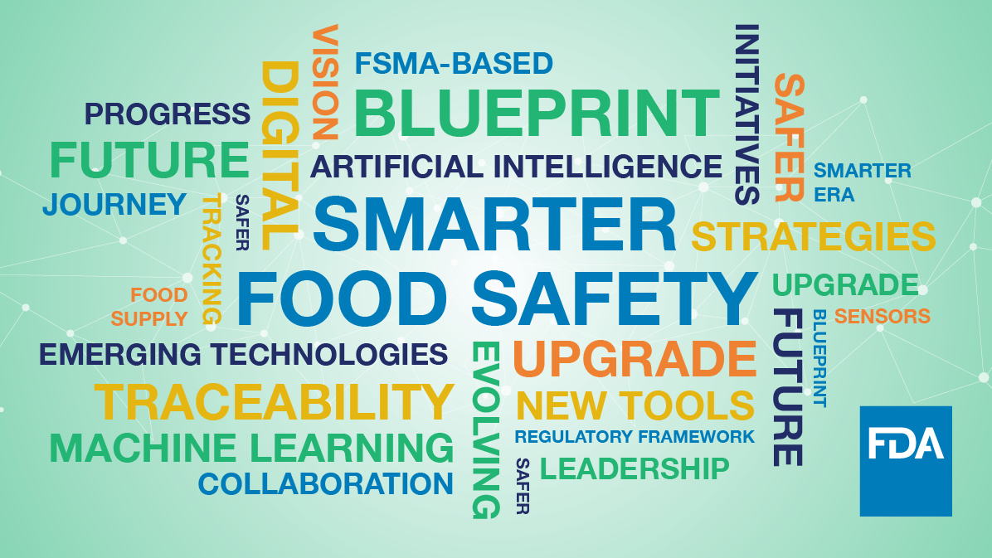
A Modern Approach for Modern Times
People-Led * FSMA-Based * Technology-Enabled

Slide 5
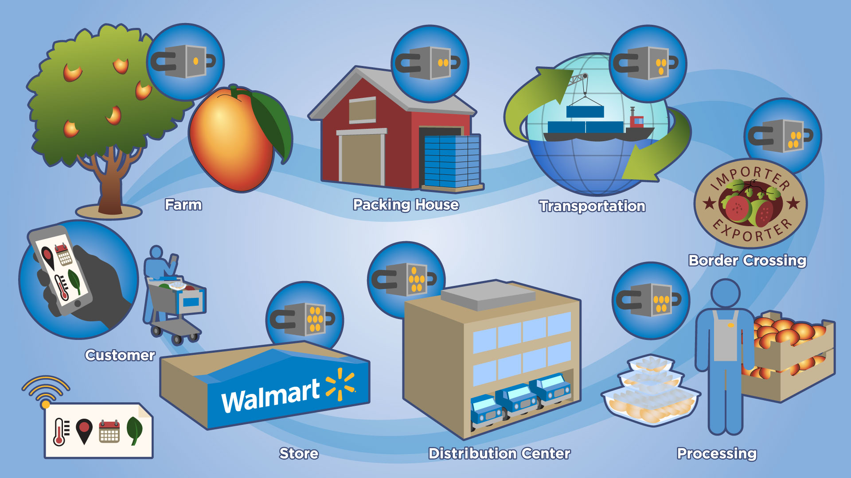
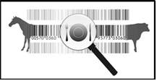
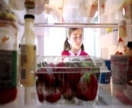
Why a digital, traceable food system matters?
foodborne illness
traceability
food fraud
The cost of foodborne illness in the U.S. alone ranges from $55 - $93 B
Inability to track & trace results in larger outbreaks & implicates safe products
Food fraud incidents cost the industry $10-15 B annually
regulatory requirements
freshness &
food waste
transparency
Food Safety Modernization Act & enhanced record keeping requirements
One -third of all food goes to waste. In the U.S., consumers throw away $29 B annually
Leads to accountably, responsibility, & TRUST. Consumers are demanding it.
Source: WHO, Ohio State Study, Markets & Markets, Forbes

Slide 6
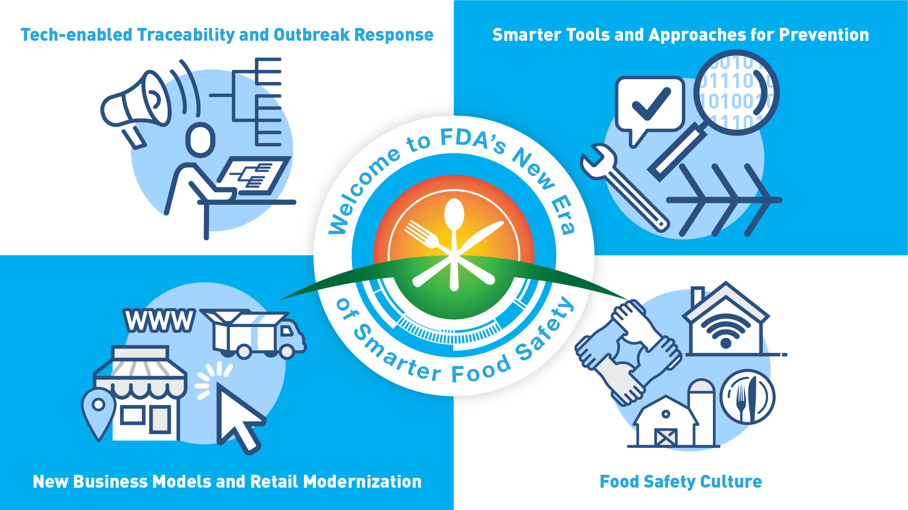

Slide 8
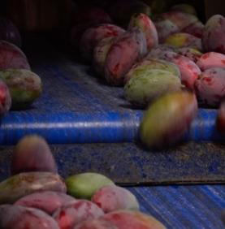
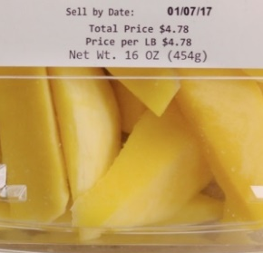
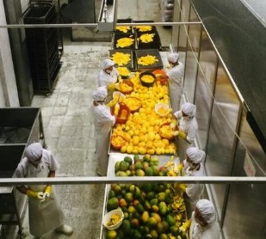
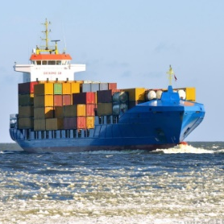
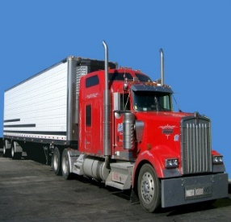
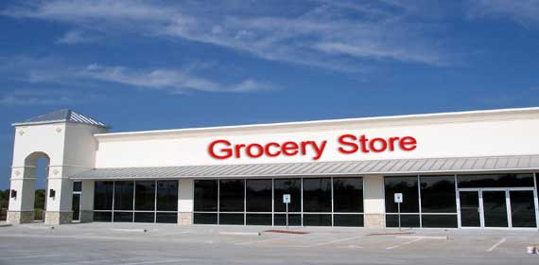
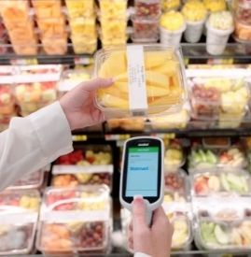
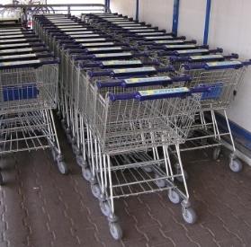
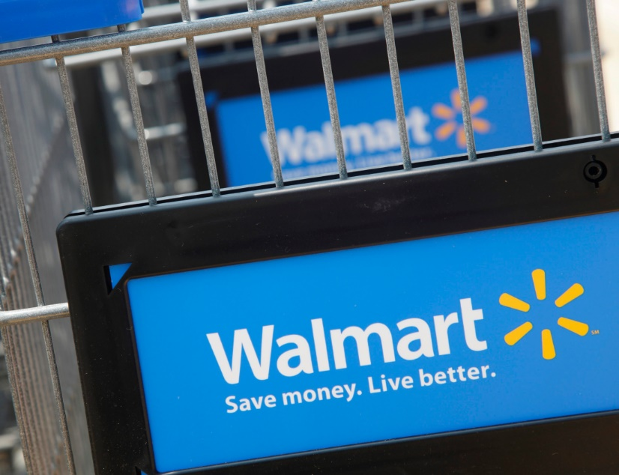

Slide 9
2.2 Seconds instead of 7 Days

Slide 10
Using AI to Prevent Violative Imported Foods from Entering Commerce

Slide 11
imagine
Food Safety
New
Paradigms

